Slide 1
MS in Applied Data Science Syracuse University Portfolio Milestone
Allan Flores
SUID: 833497871

Slide 2
Background
B.S. in Industrial Engineering
Supply Chain Management Director
Monde Nissin Corporation, Mead Johnson Nutrition, Nestle, Sanofi, Novartis, Saputo Foods Dairy
Project Covered
Kobe Bryant Shot Selection (Big Data - Python)
Inbound Crossing at the US-MEXICO AND US-CANADA Border (Visualization - R)
Investing in Top 3 Zip Codes (Time Series Analysis - Python)

Slide 3

Kobe Bryant
Shot Prediction and
Financial Impact to Lakers

Slide 4
Sports analytics has become a popular topic in the data science field where the term has been popularized with the release of the 2011 film, Moneyball.
The game of sports maybe different among popular sports of baseball, hockey, football, and basketball, but the underlying principle governing the idea of analyzing and predicting outcome in sports performance is identical.
Kobe Bryant was an icon in the history of basketball and we want to leverage on data collected from his entire career.
Therefore, we would like to get an experience in sports analytics.
Motivation

Slide 5
Using Kobe Bryant’s stats throughout 20 years of his NBA career, we want to build several models to predict whether his shot will make or miss it.
The other part of our project is to determine if there is any correlation between Kobe Bryant’s performance and the revenue and profitability of the NBA team LA Lakers using exploratory and/or Machine Learning Techniques.
Business
Questions

Slide 6
Part 1 - Analyses of shots made by Kobe Bryant (sourced from Kaggle dataset).
Part 2 – Analyses of Kobe’s performance in relation to team’s performance, revenue and profitability.
Collection of Data – 2 Parts

Slide 7
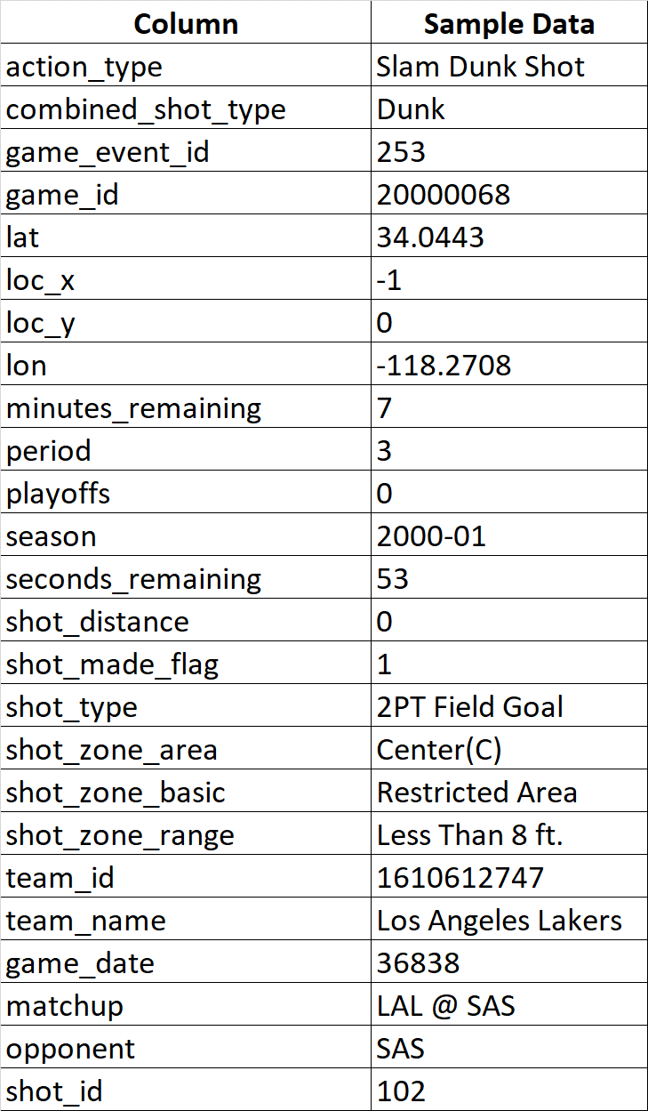
The Collection of Data – Part 1
Kobe Bryant Shot Selection Data
Primary source of dataset is from Kaggle competition titled. “Kobe Bryant Shot Selection” (https://www.kaggle.com/c/kobe-bryant-shot-selection/overview/description) for the player’s statistics.
Each of the observation represents a shot taken by Kobe Bryant over the data collection period.
Period covered from years 1996 to 2015

Slide 8
Pre-Processing and Data Cleaning – Part 1
Removed from the dataframe for column, “shot_made_flag” with null values leaving us 25,697 shots from 30,697.
This is 16% reduction from the original number of observations.
Converted game date to date time variable for future analyses.
Grouped game date at yearly level to plot the number of games per year.

Slide 9
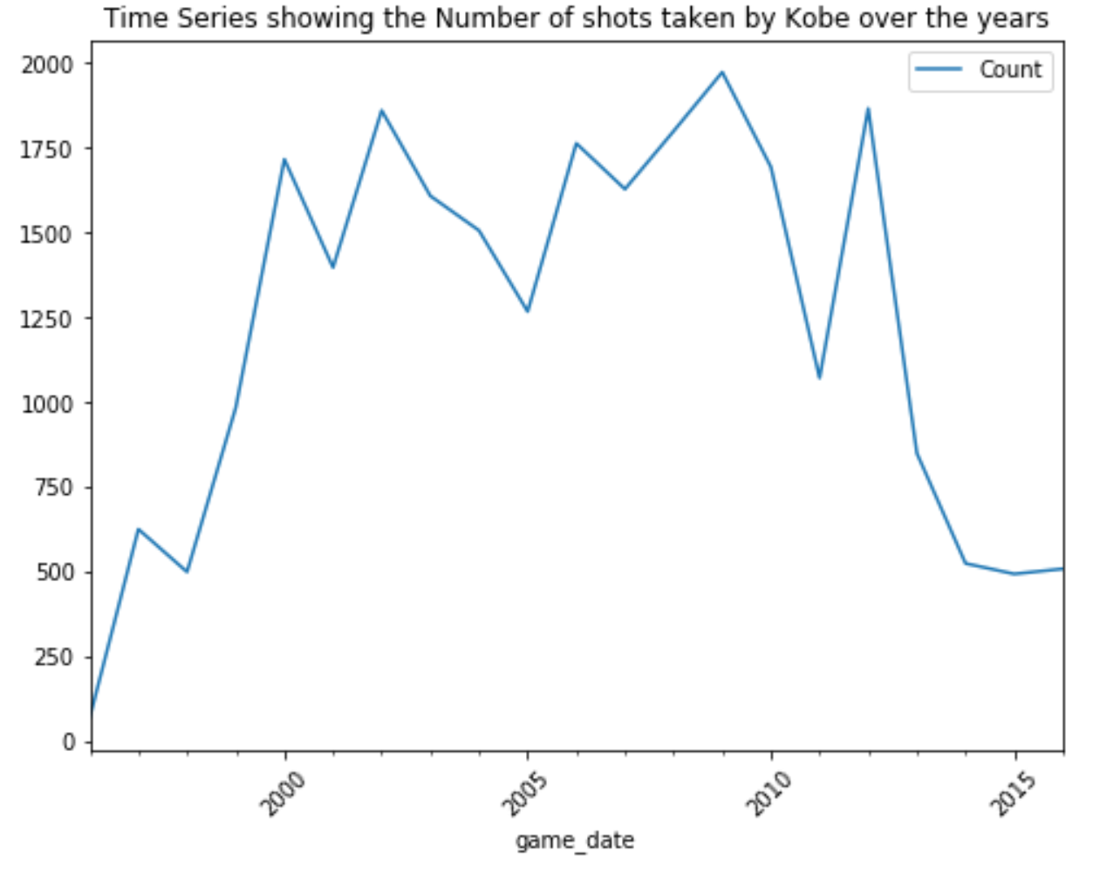
Exploring the Dataset – Part 1
There was a steady increase in the number of shots until year 2000.
His shots stabilized with some variations from years 2000 to 2011.
His shots started to decline in Y2011 until his retirement in Y2016.
It was around Y2011-12 when Kobe suffered from a torn wrist ligament.
Kobe started his career with Lakers in Y1996.
2011-12 Kobe suffered a torn wrist ligament injury.
Retirement

Slide 10
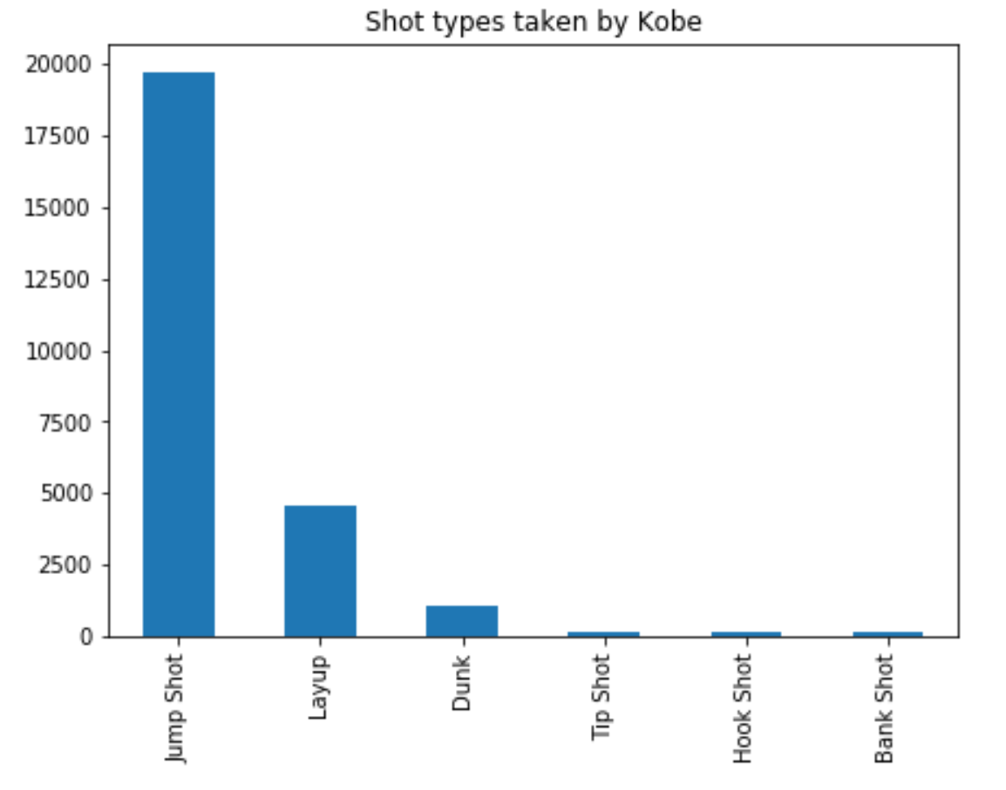
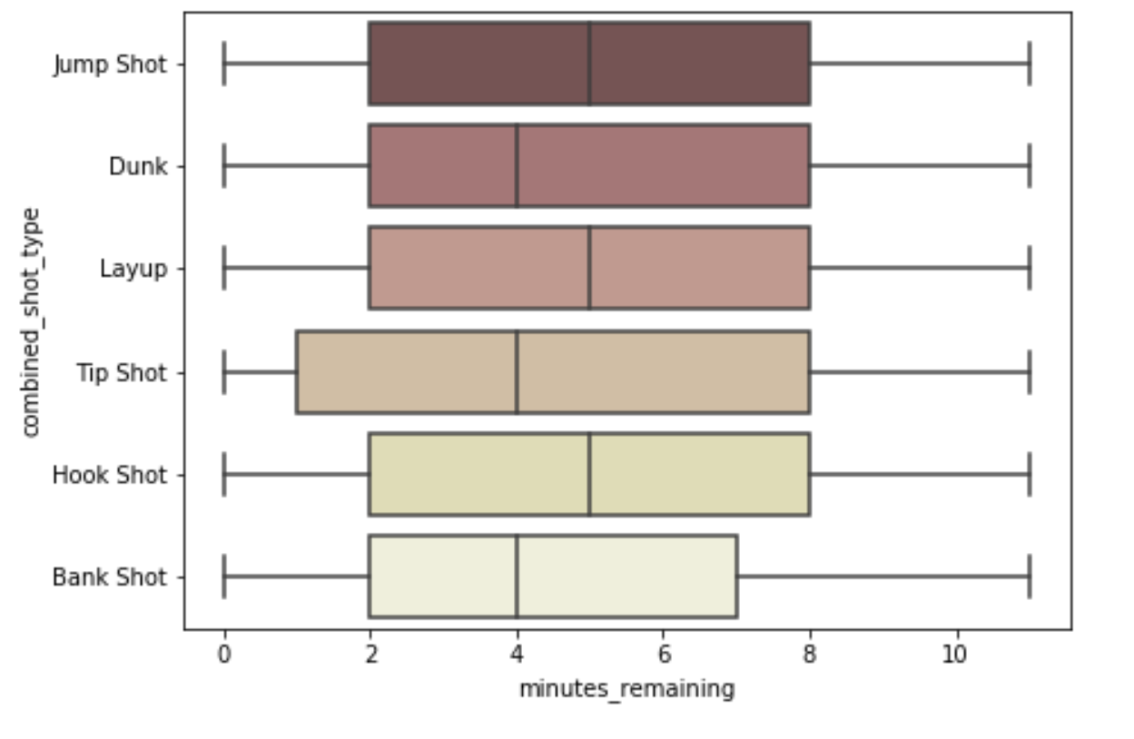
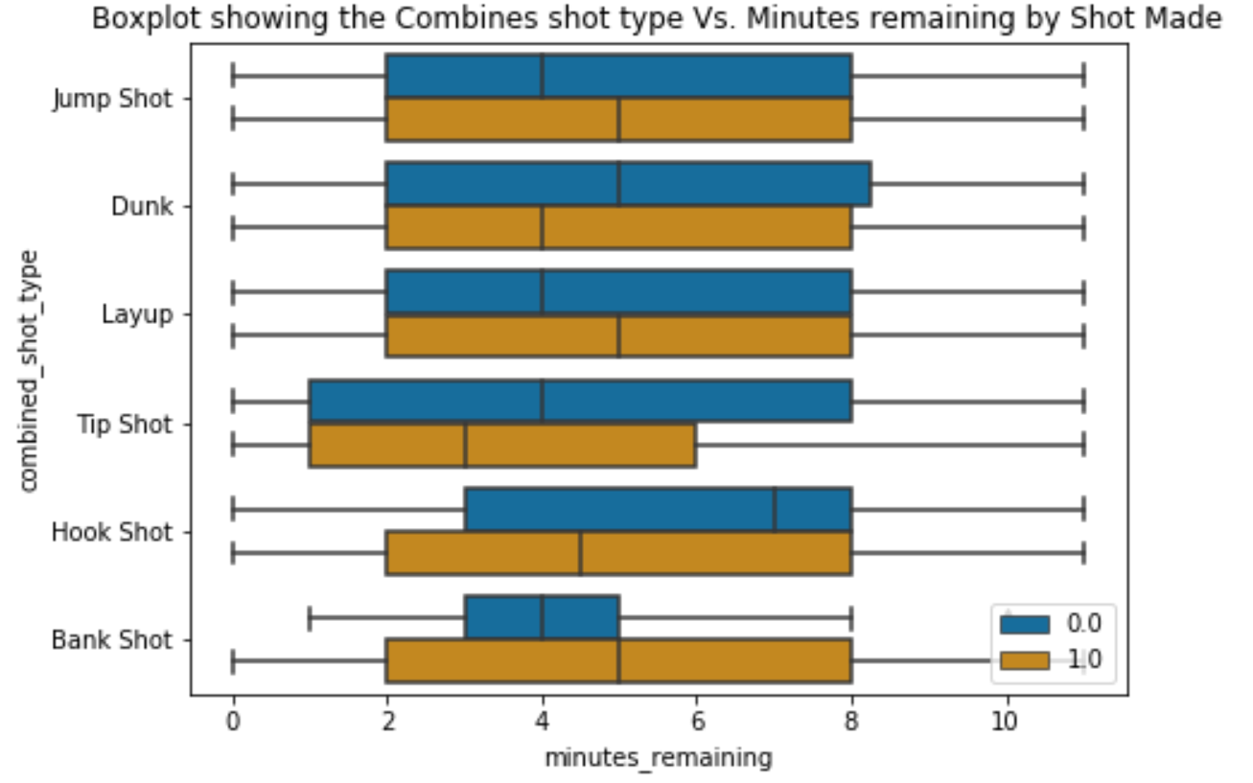
Exploring the Dataset – Part 1
With 4 - 5 minutes remaining, the tip shop had the highest distribution, while bank shots had the lowest distribution.
Tip shots had the lowest median in terms of successful shots.
Kobe took different kinds of shots at an average of 4 – 5 minutes remaining. The tip shop had the highest distribution.
Majority of the shot type taken by Kobe was a jump shot.
Success
Failure

Slide 11
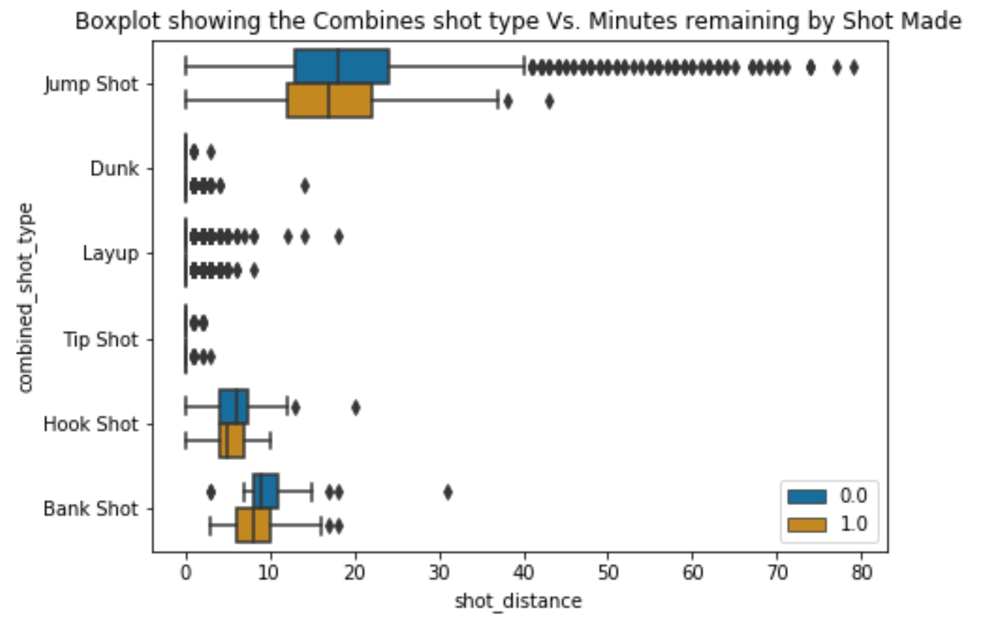
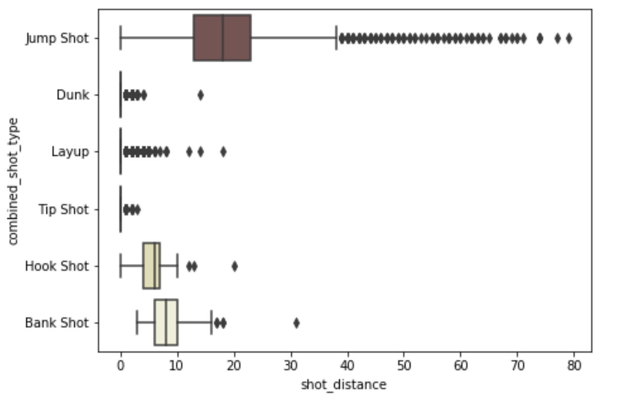
Exploring the Dataset – Part 1
Jump shot had the widest distribution in terms of distance at a median of ~20 meters away from his court.
In general, the distribution of failed shots as compared to successful shots were wider except for dunk and tip shot.
Success
Failure

Slide 12
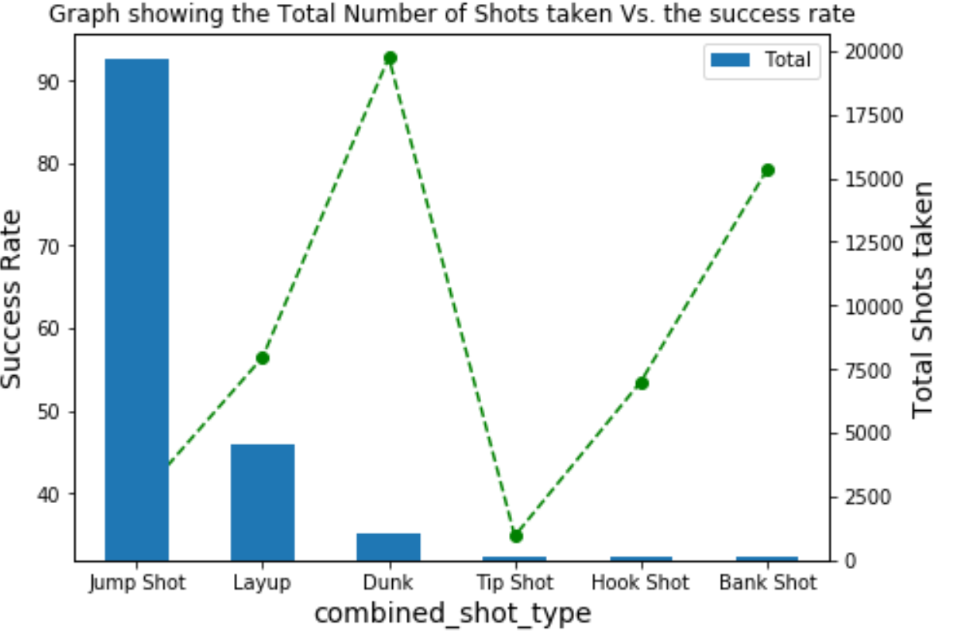
Exploring the Dataset – Part 1
93%
Jump shots with majority of the shots only had 39% success rate.
Tip shots had 34% success rate.
Dunk had the highest success rate of 93%.
39%
34%

Slide 13
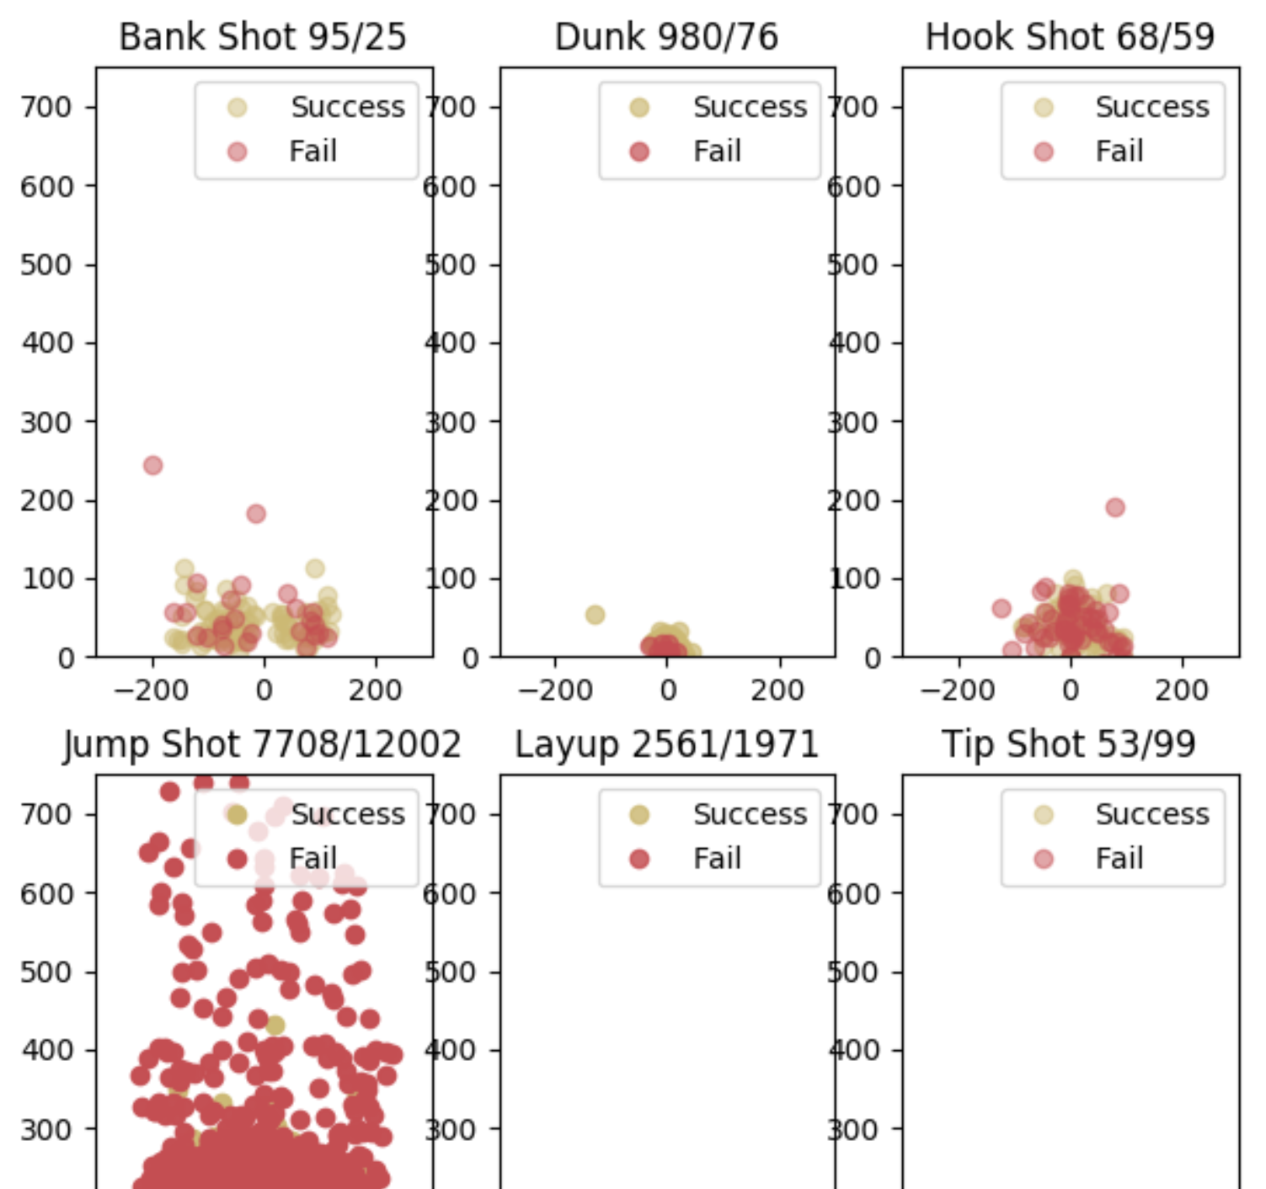
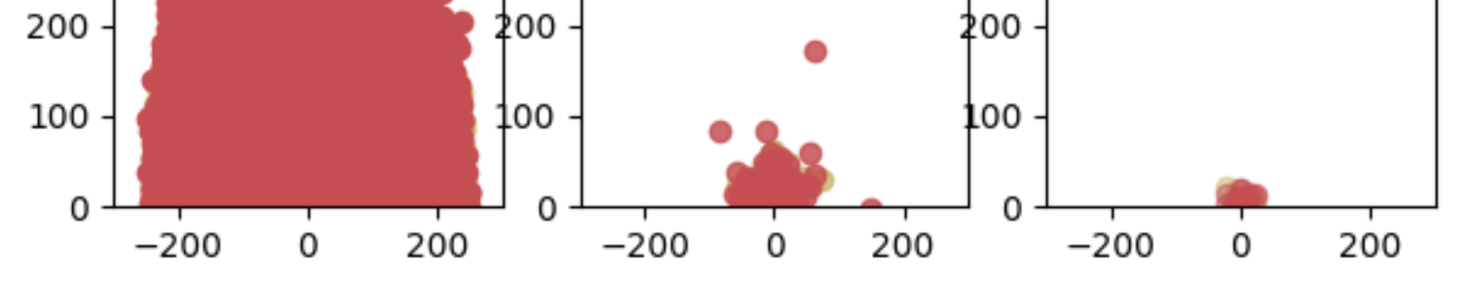
Exploring the Dataset – Part 1
More successful shots for bank shot and dunk.
Less successful for jump shot, layup, tip shot, and hook shot.

Slide 14
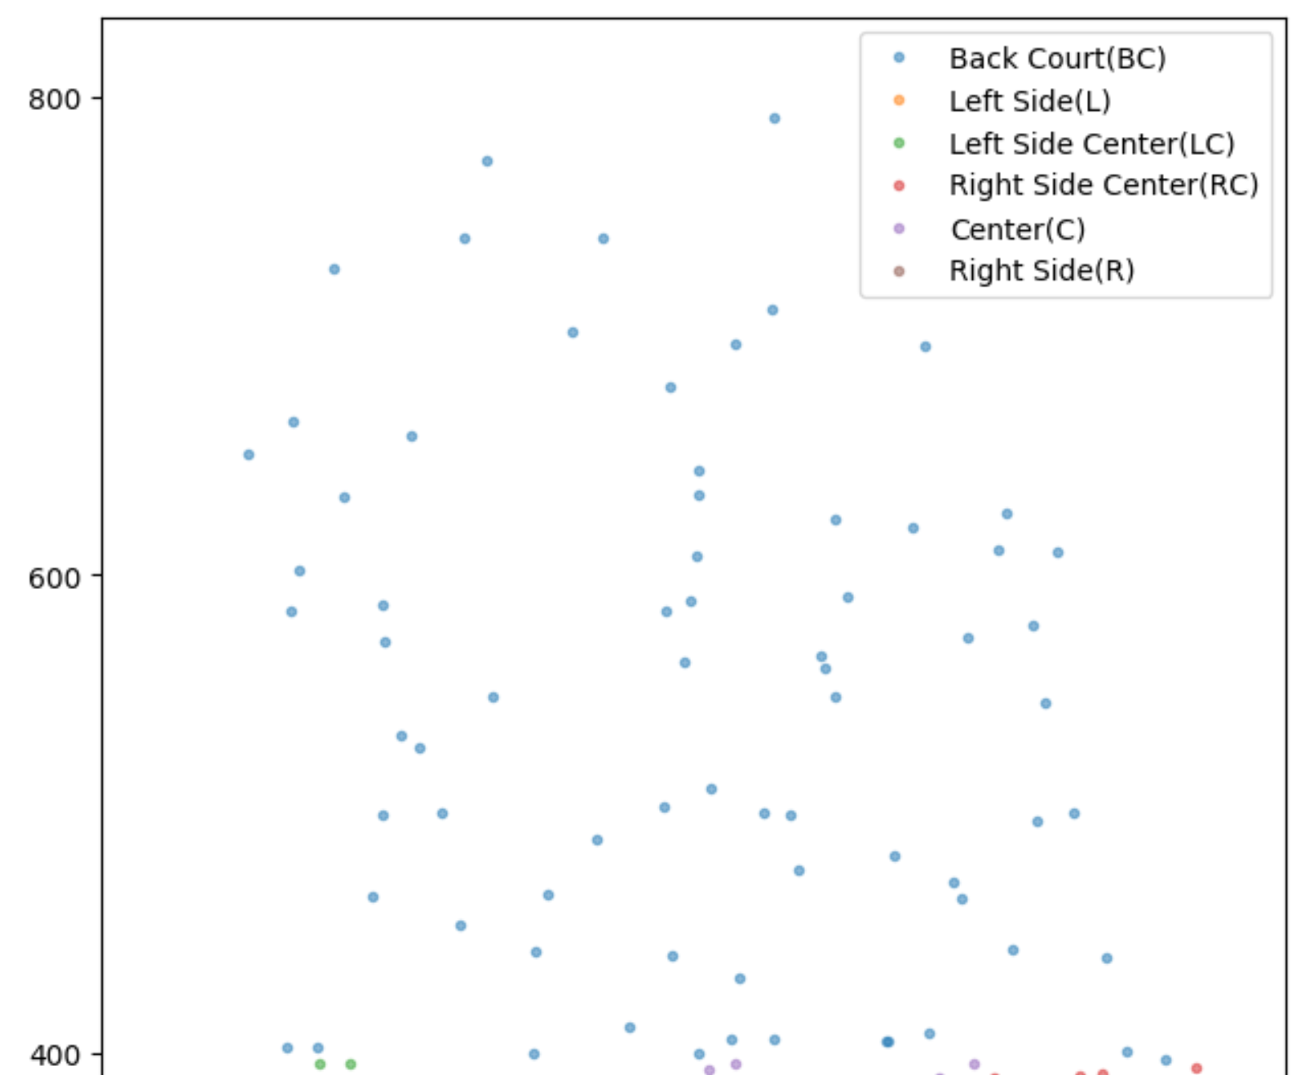
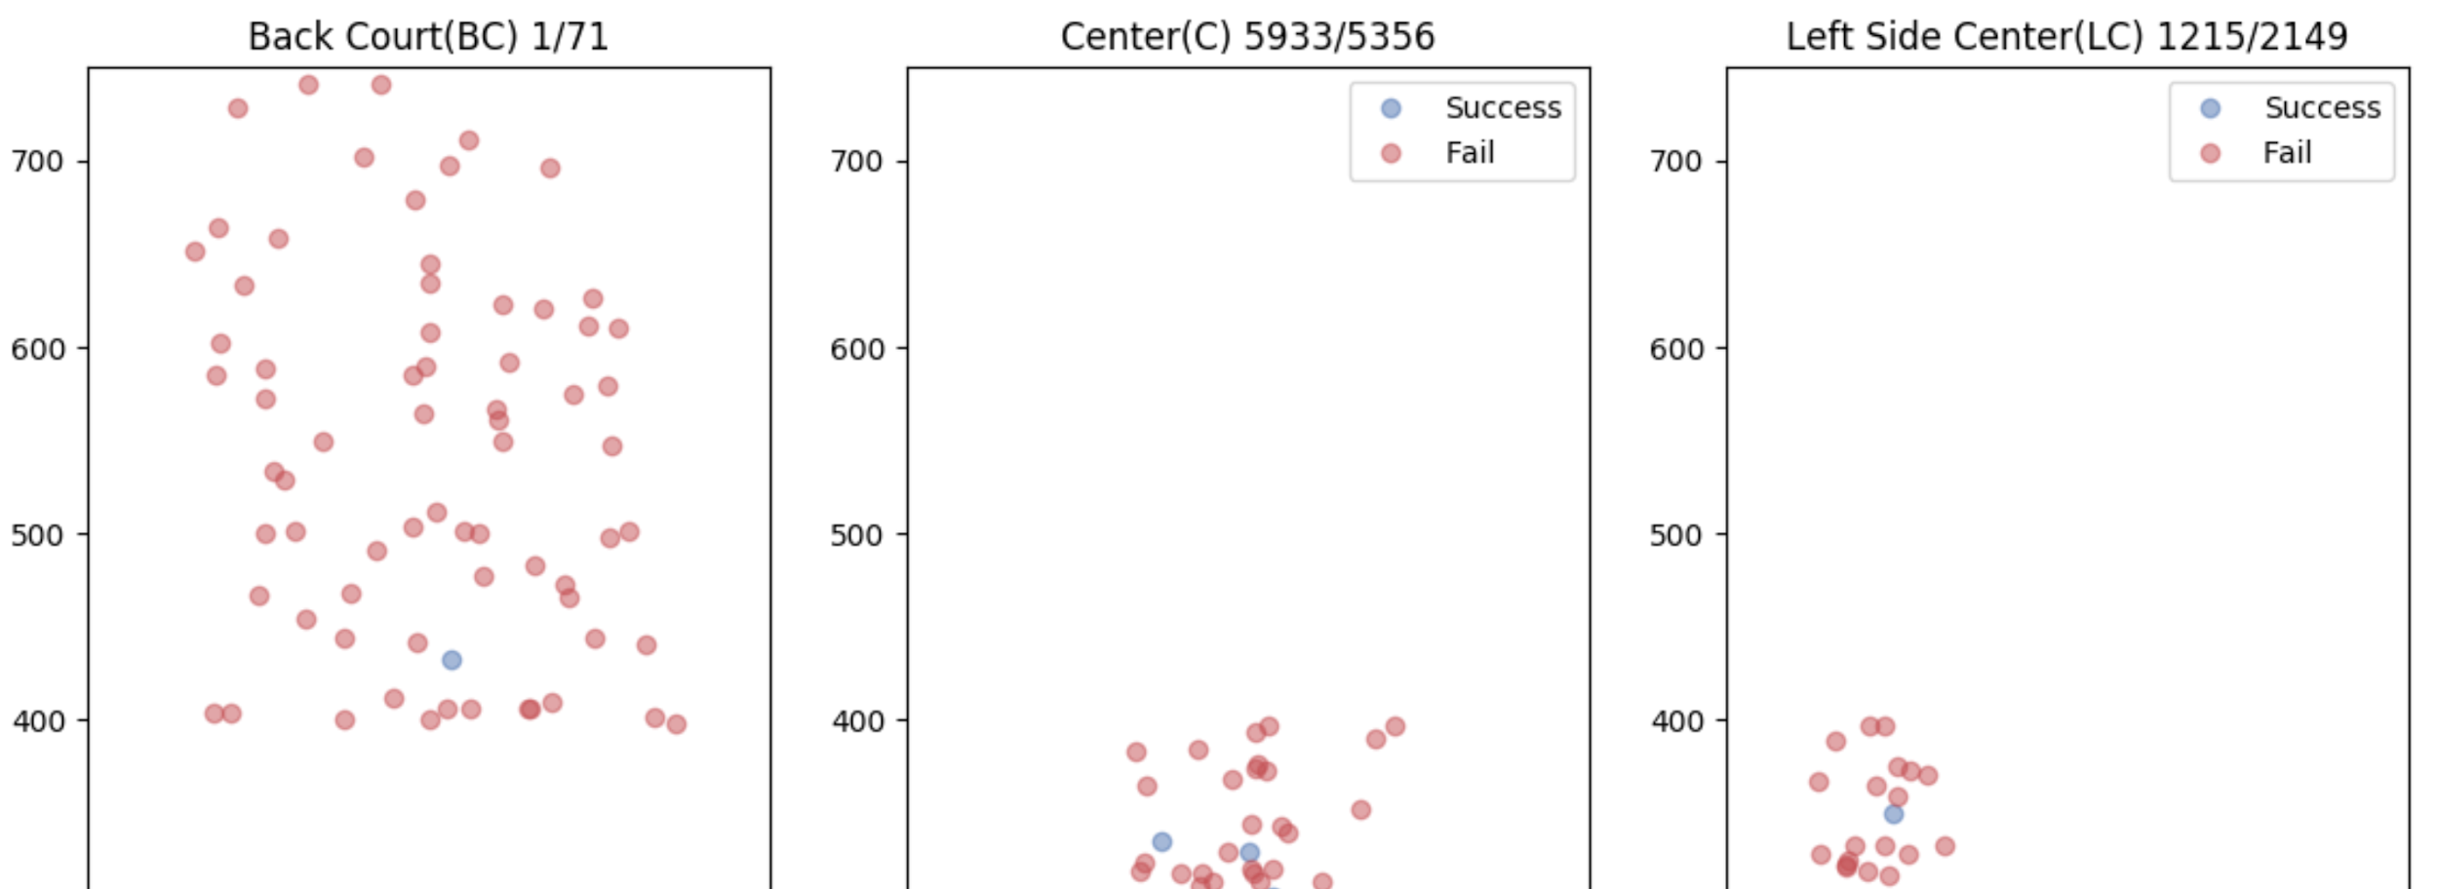
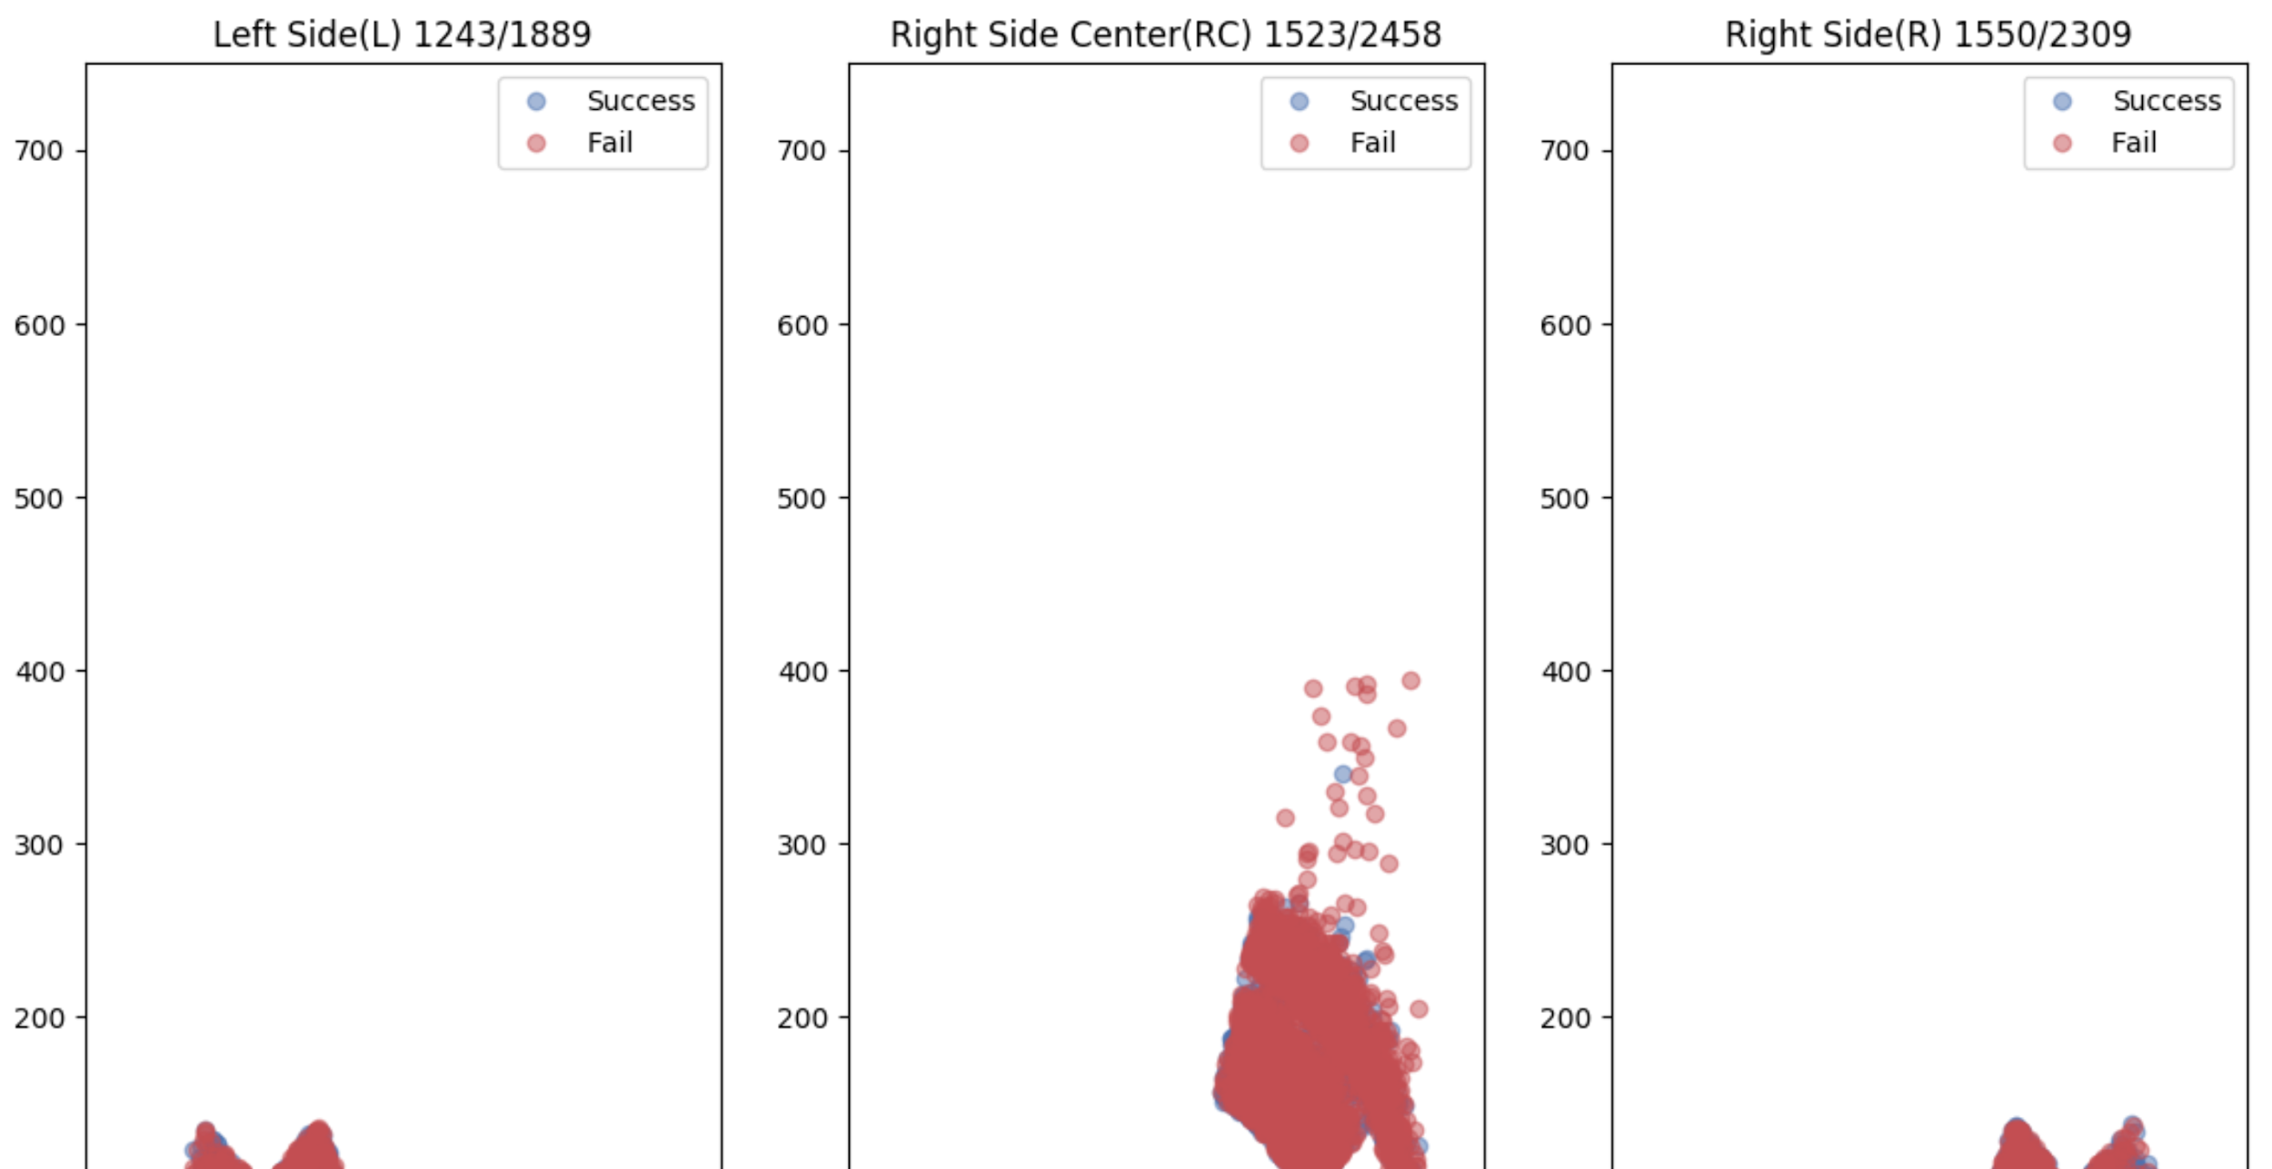
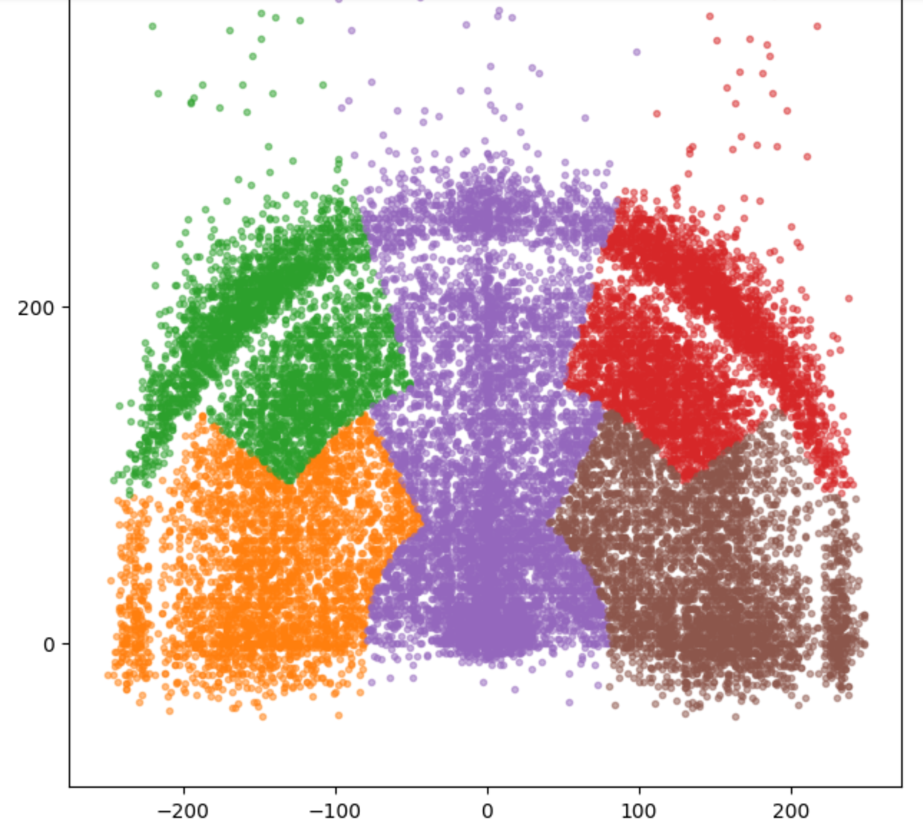
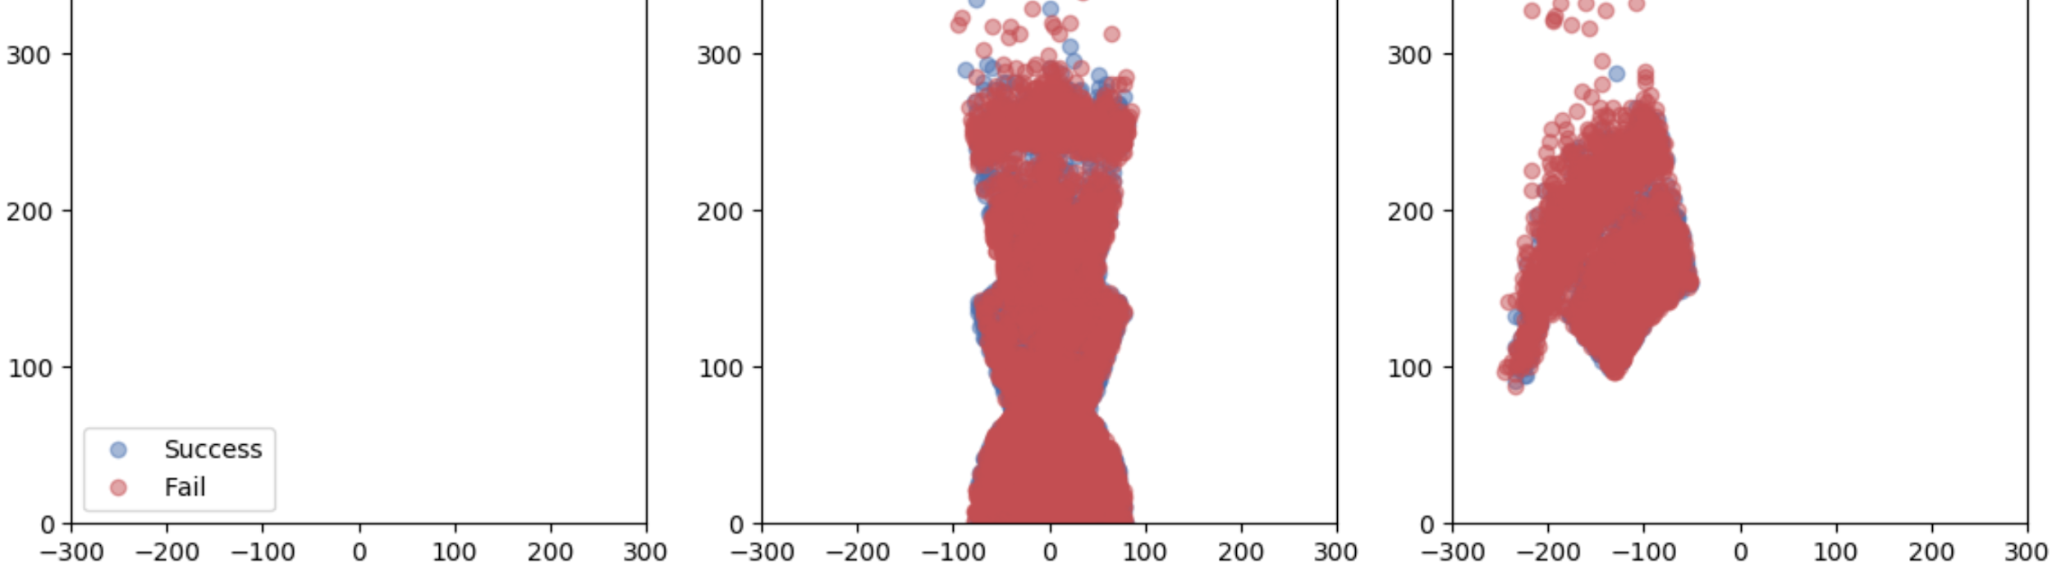
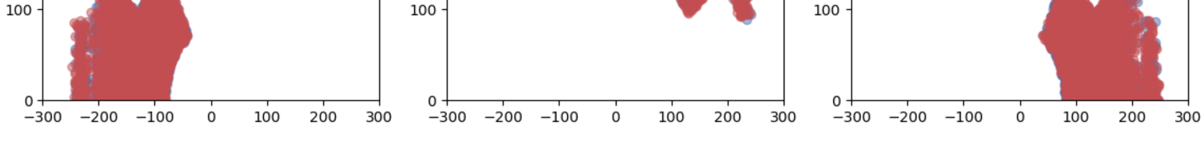
Exploring the Dataset – Part 1
More successful shots can be seen when taken at the center of the court.

Slide 15
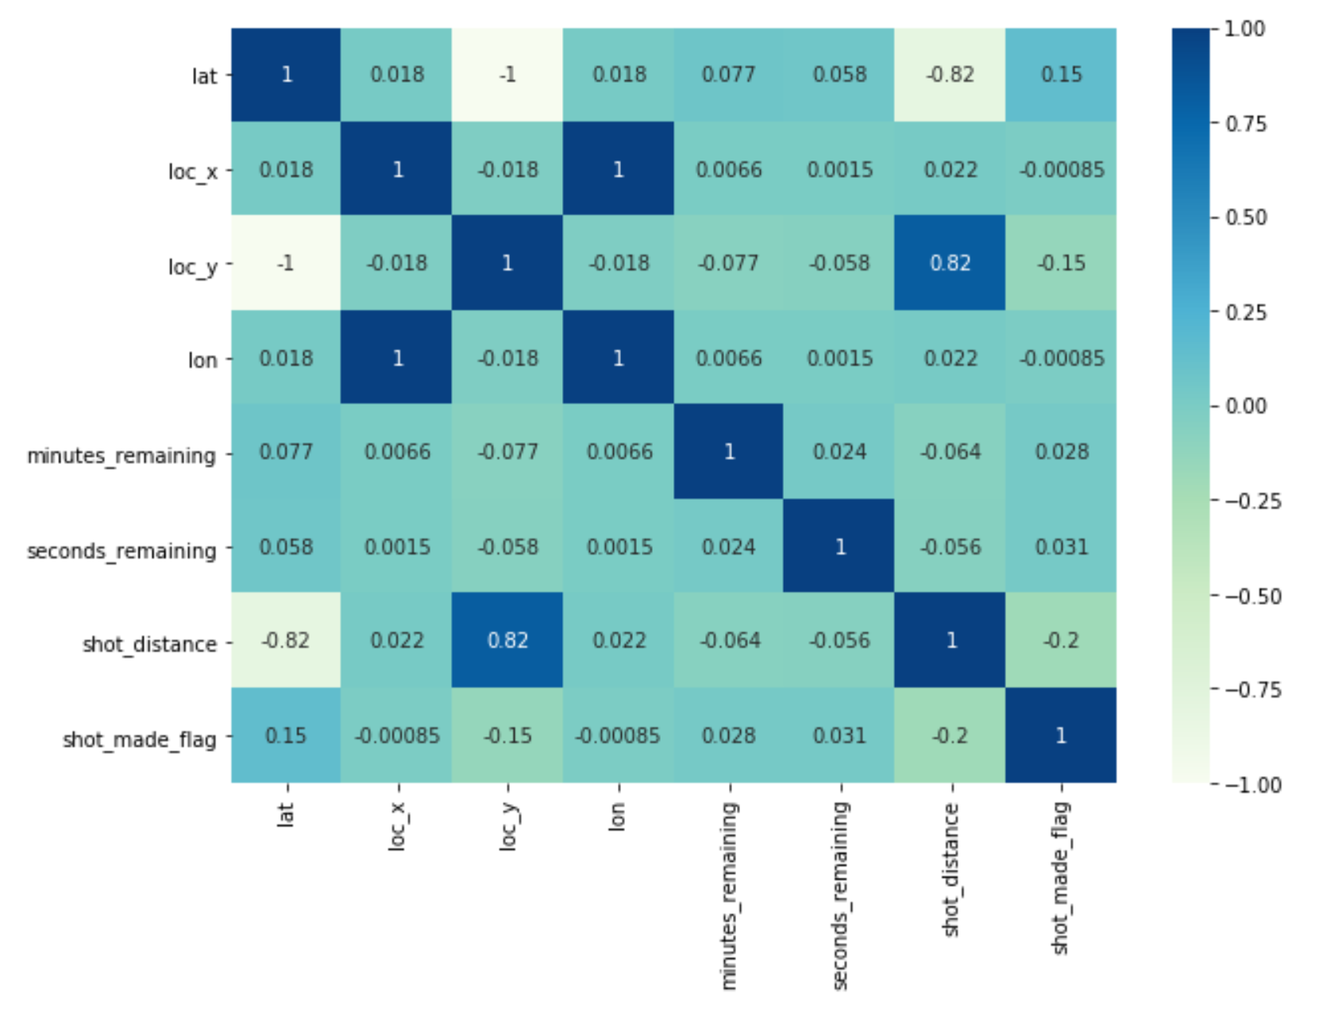
Model – Part 1
Feature Selection:
Removed highly correlated values.
lat and loc_y have a perfect negative correlation.
lon and loc_x have a perfect +ve correlation.
Shot distance is also correlated to lat and loc_y as well with a strength of -0.82 and +0.82, respectively.

Slide 16
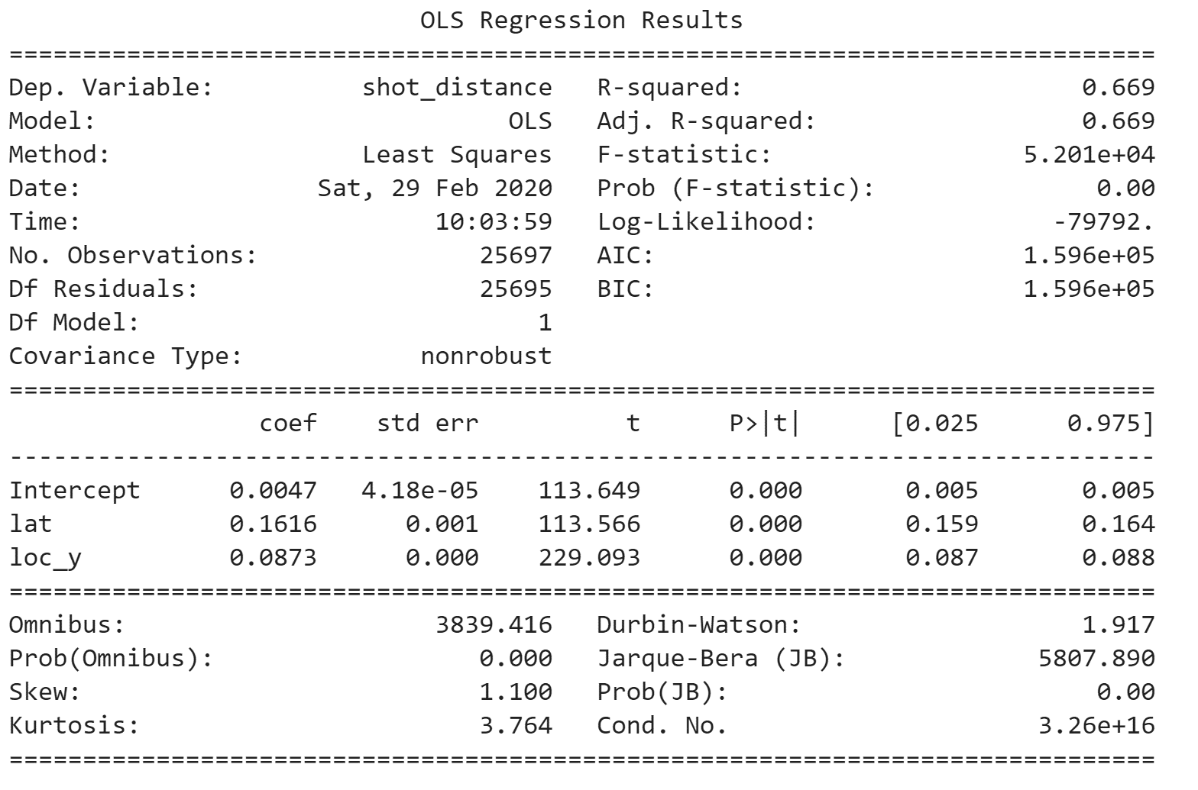
Model Part 1 – OLS Regression
Loc_y and lat explain the 66.9% of the variance in shot distance.

Slide 17
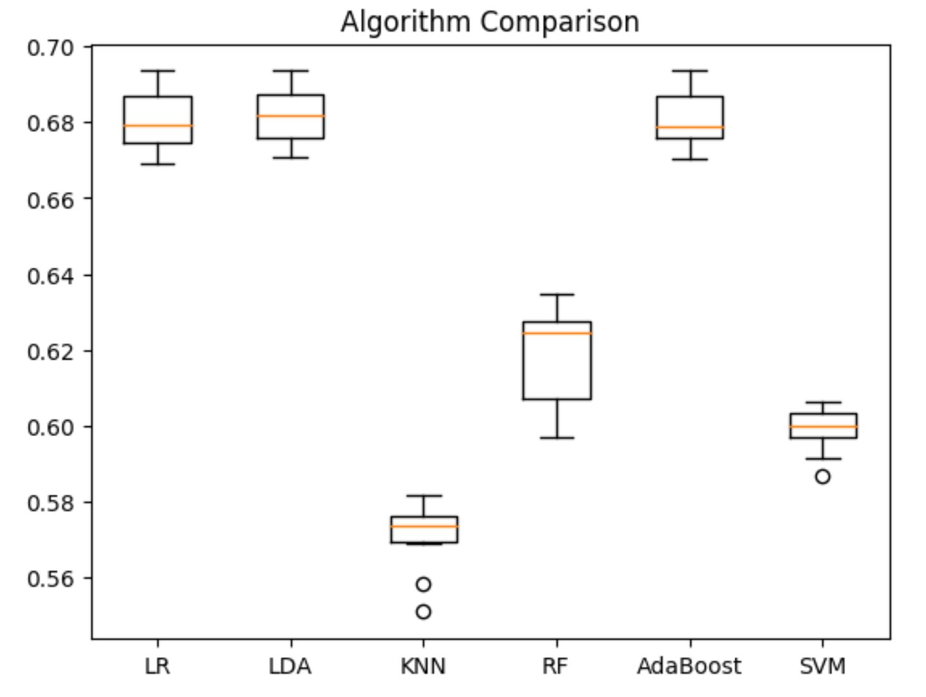
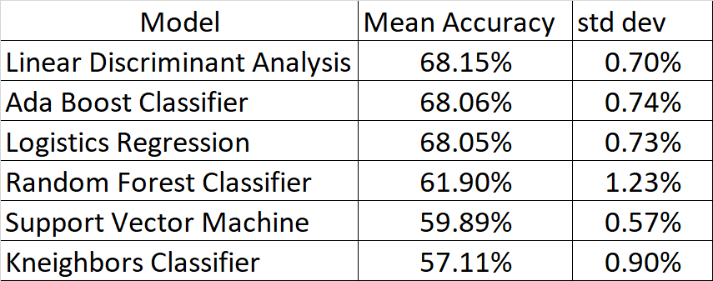
Model Part 1 – LR, LDA, KNN, RF, AdaBoost, SVM
LDA, AdaBoost and LR are the most accurate models in predicting shots.

Slide 18
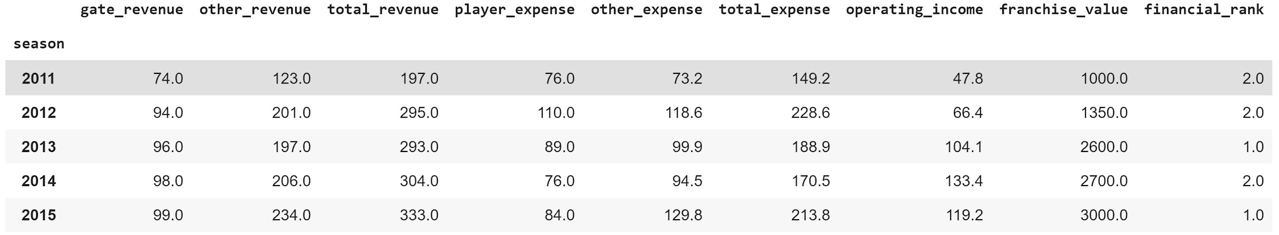
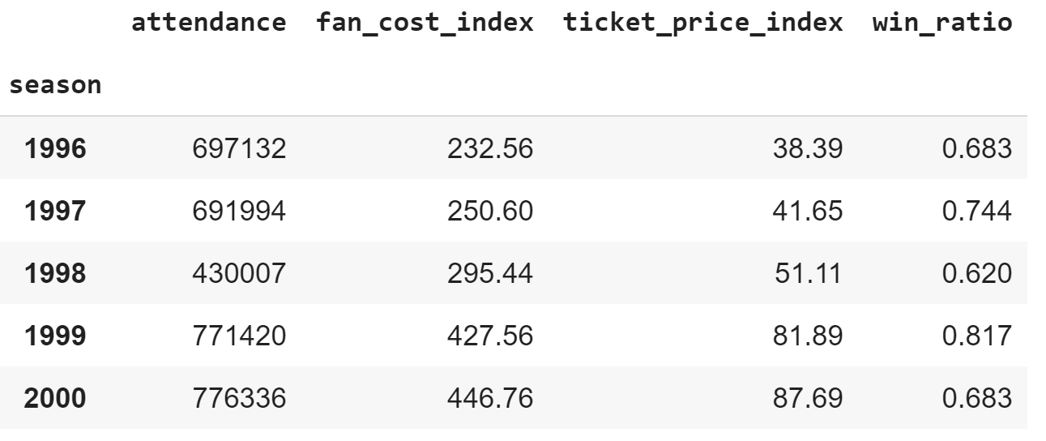
The Collection of Data – Part 2
Annual Income and Expense Data
Columns selected in the final data frame
From Rodney Fort’s sports financial data
https://sites.google.com/site/rodswebpages/codes
redirect to : https://drive.google.com/drive/folders/1pr_yPm9oPLcfCtWOtnrLoJdvzFDbYBAk
Lakers financial performance by year from 1996 to 2015
Annual Ticket Price and Fan Cost Data
From Rodney Fort’s sports financial data
Lakers game performance from 1996 to 2015

Slide 19
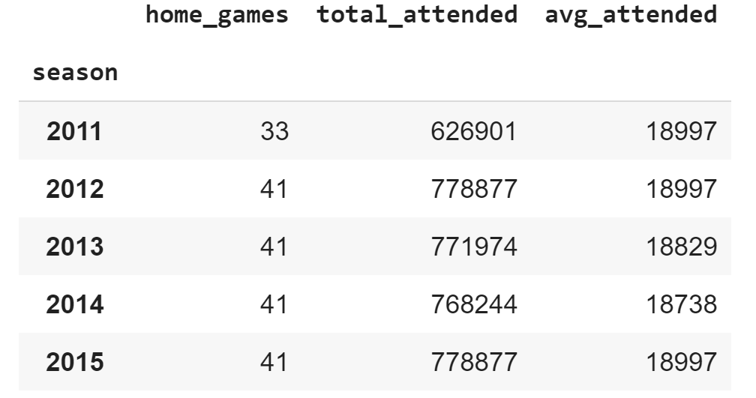
The Collection of Data – Part 2
Lakers Attendance
Columns selected in the final data frame
Data provided by the Association of Professional Basketball Research
https://www.apbr.org/attendance.html
Years covered from 1960 to 2015
Lakers Annual Record
Sourced from Sports Reference API, Robert Clark
https://sportsreference.readthedocs.io/en/stable/nba.html
Installed ‘sportsreference’ and chose Lakers annual records from 1996 to 2016
Data selected:
Wins
Losses
Wins Ratio = Wins / (Wins + Losses) – Derived column

Slide 20
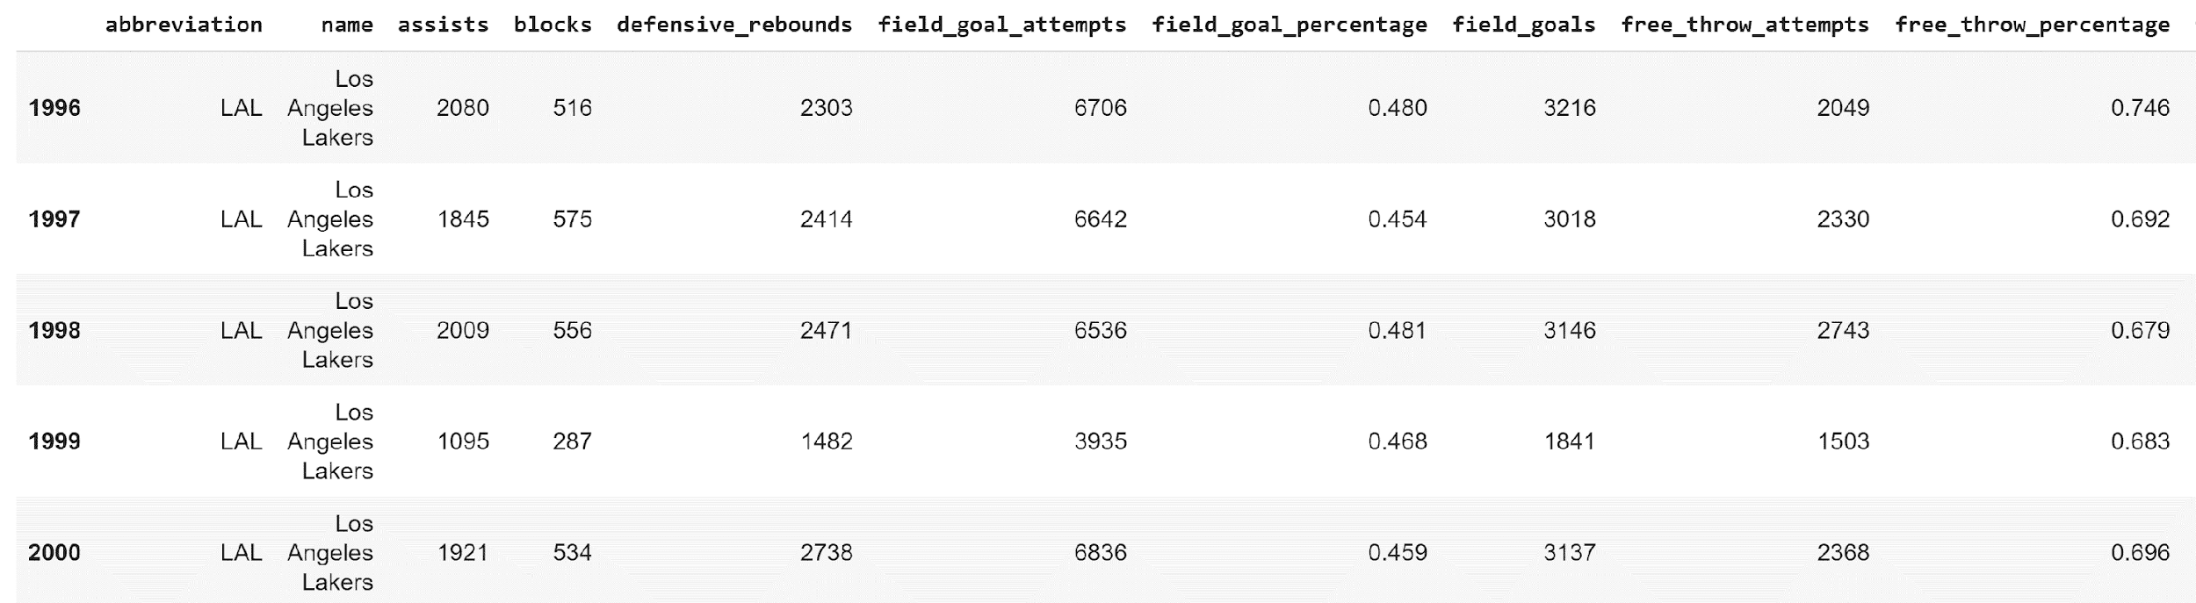
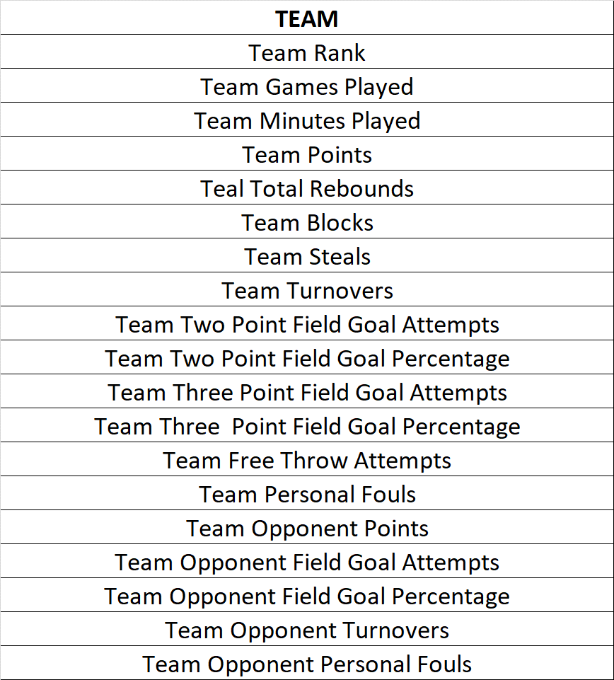
The Collection of Data – Part 2
Lakers Team Data
Data selected (excerpt):
Sourced from Sports Reference API, Robert Clark
https://sportsreference.readthedocs.io/en/stable/nba.html
Installed ‘sportsreference’ and chose Lakers annual records from 1996 to 2016
Final data selected:

Slide 21
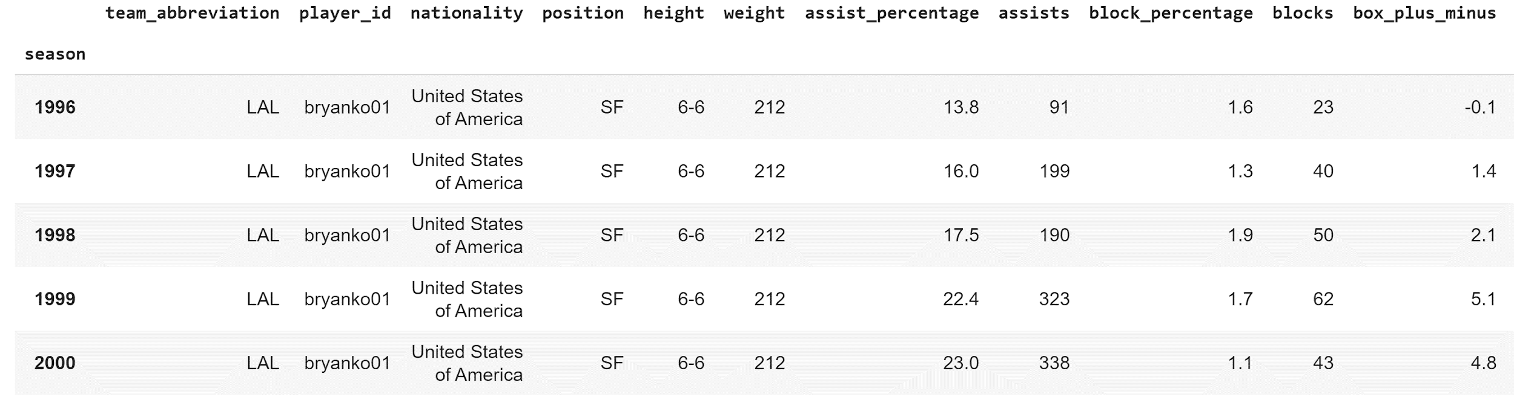
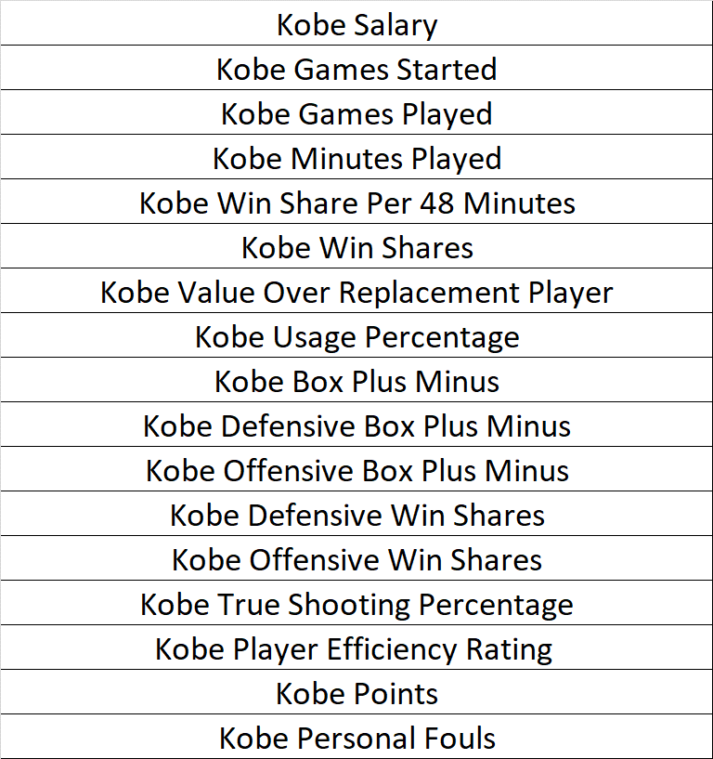
The Collection of Data – Part 2
Data selected (excerpt):
Player’s Career Data – Kobe Bryant Data
From ‘sportsreference.nba.roster’ import Player
Selected player, “bryanko01” to extract Kobe’s statistics
Final data selected:

Slide 22
Pre-Processing and Data Cleaning – Part 2
Combined all relevant team, and Kobe data through merge function
Operating income and franchise value
Fan cost and ticket price index
Attendance
Record (wins, losses, wins ratio)
Team data (team statistics)
Kobe data (Kobe’s statistics including his salary)
Generated a normalized data frame to be used for some analyses

Slide 23
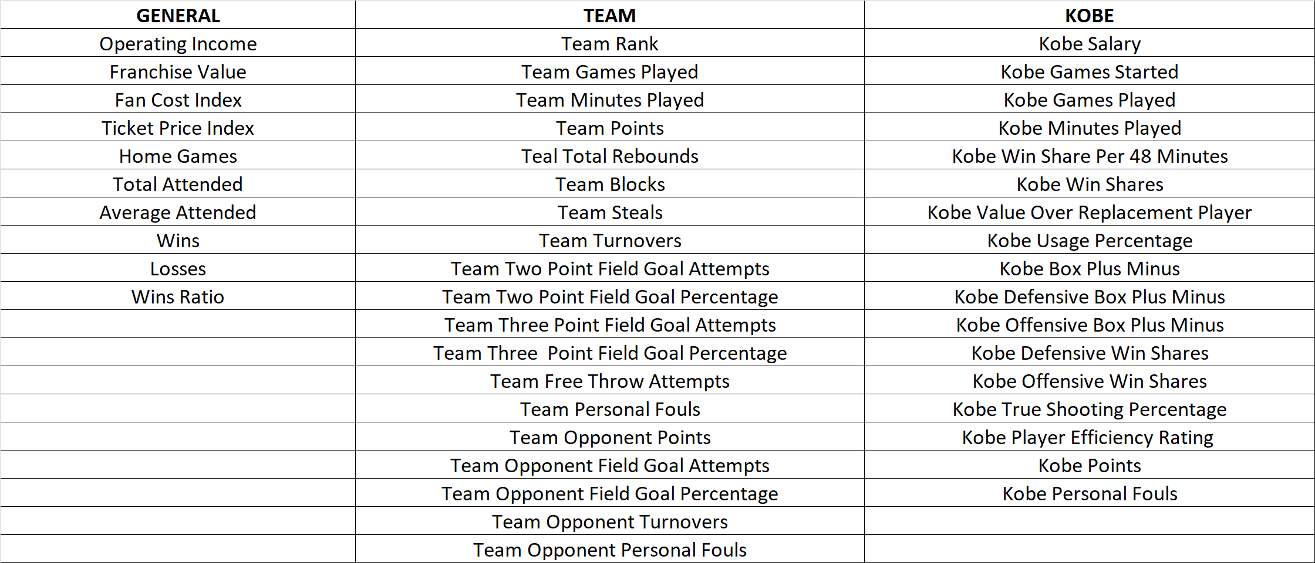
Pre-Processing and Data Cleaning – Part 2
Final Data Frame

Slide 24
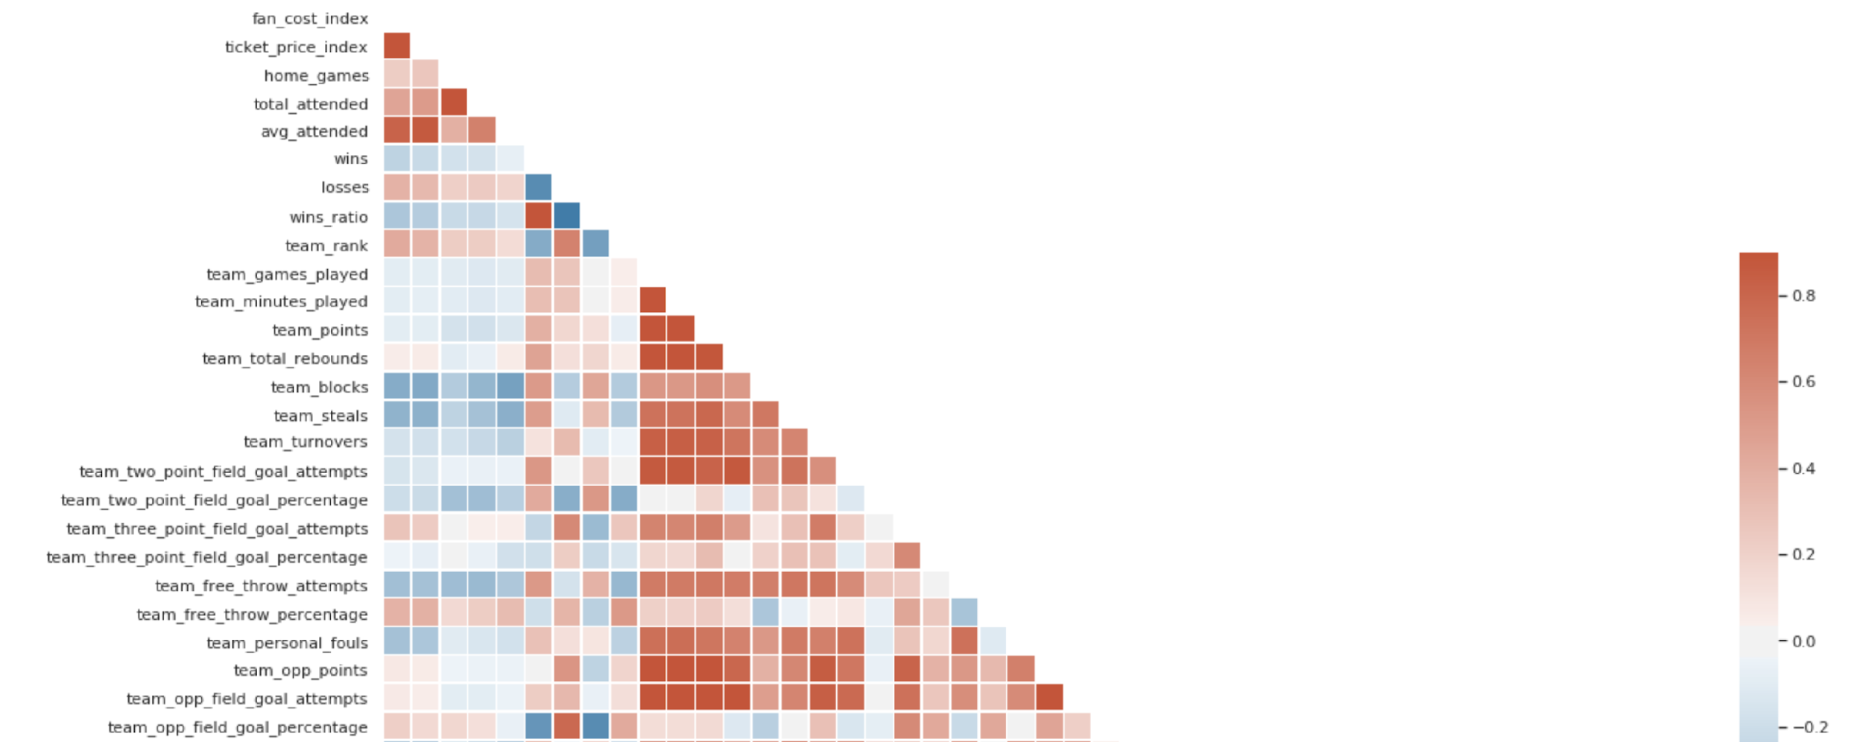
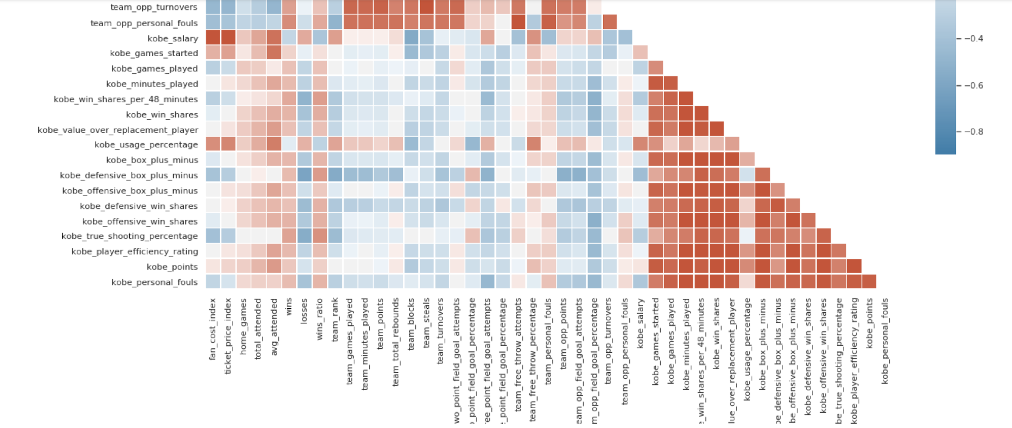
Exploring the Dataset – Part 2
The team performance are correlated with itself and not with Kobe’s.
Ticket prices and general fan costs are positively correlated with Kobe’s salary.
Opponent’s field goal % is closely correlated with Lakers’ wins and losses.
Avg. attendance is slightly negatively correlated with team blocks and slightly positively correlated with Kobe’s games played.
Team
Kobe

Slide 25
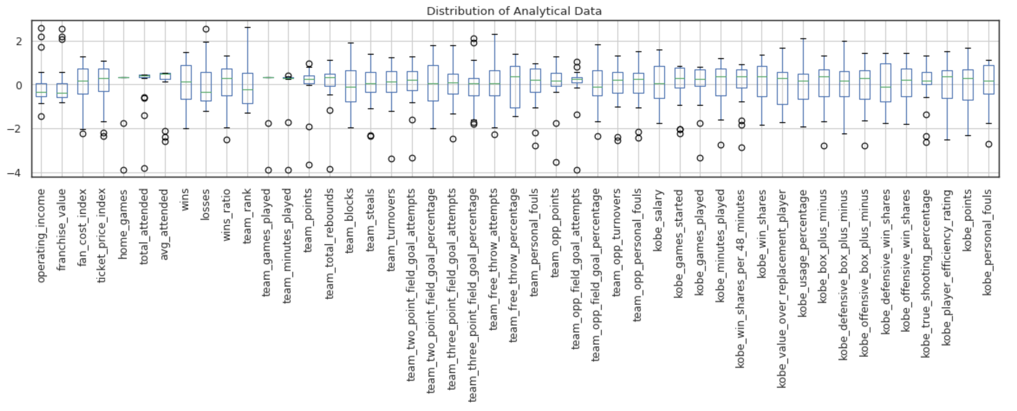
Exploring the Dataset – Part 2
GENERAL
TEAM
KOBE
- Most team performance are normally distributed except for personal fouls and free throw percentage.
- Ticket price and fan cost indices are negatively skewed, but attendance varies only slightly throughout time.
- Most of the Lakers final ranking are on the lower side outside of some good years.
- Kobe’s statistics are all relatively normally distributed expect for personal fouls, that are negatively skewed.
- All aggregate measures of Kobe’s performance show positive results for most of his career.

Slide 26
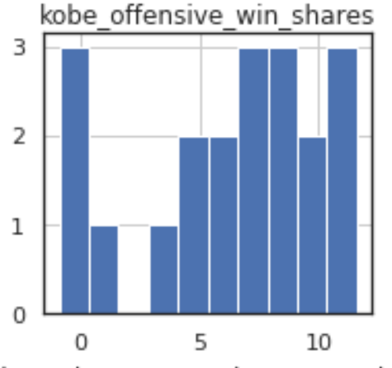
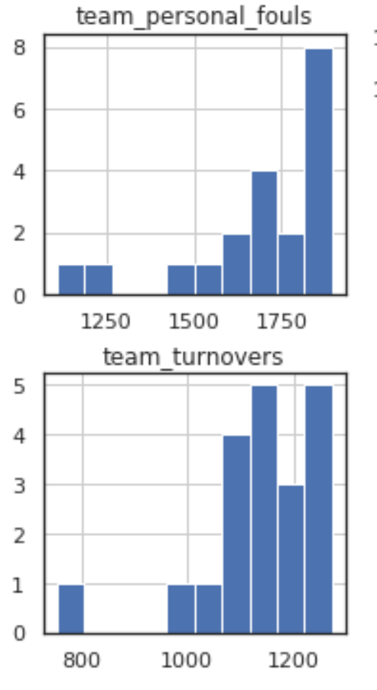
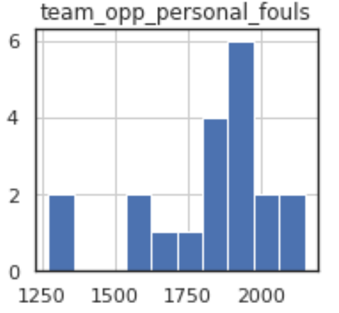
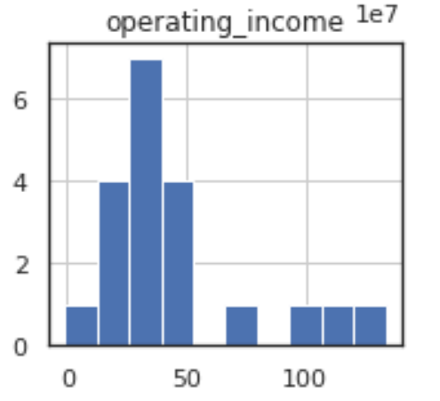
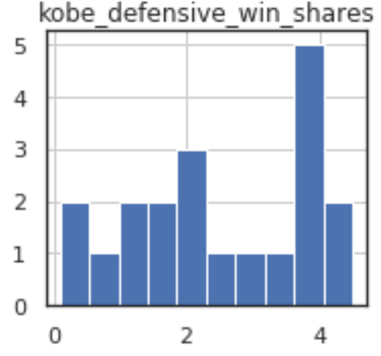
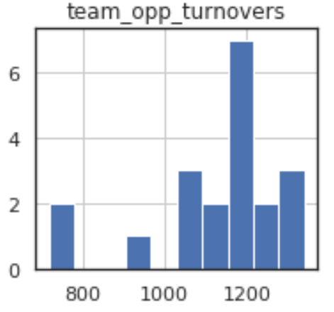
Exploring the Dataset – Part 2
Kobe appears to have a stronger offensive win shares rate than defensive win shares rate.
Operating income centralizes between $0 to $50M during most years except for four high years.
Team personal fouls and turnovers are negatively skewed, more so than their opponents.

Slide 27
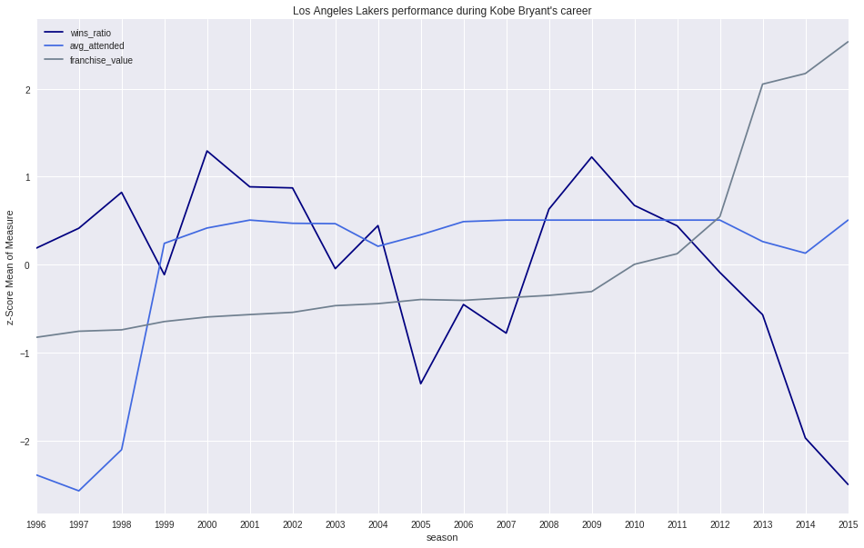
Exploring the Dataset – Part 2
Average attendance totals appear to be relatively flat throughout much of Kobe’s career.
Franchise value increases steadily from 1996, with an exponential increase starting in 2009.
Franchise value appears unaffected by changes in attendance, wins, etc.
Attendance appears to fluctuate most at the end of Kobe’ career.
Staples Center opened in 1999 with a capacity of 19k
Franchise value begins exponential increase with new television contract, including broadcasting NBA games in China
c

Slide 28
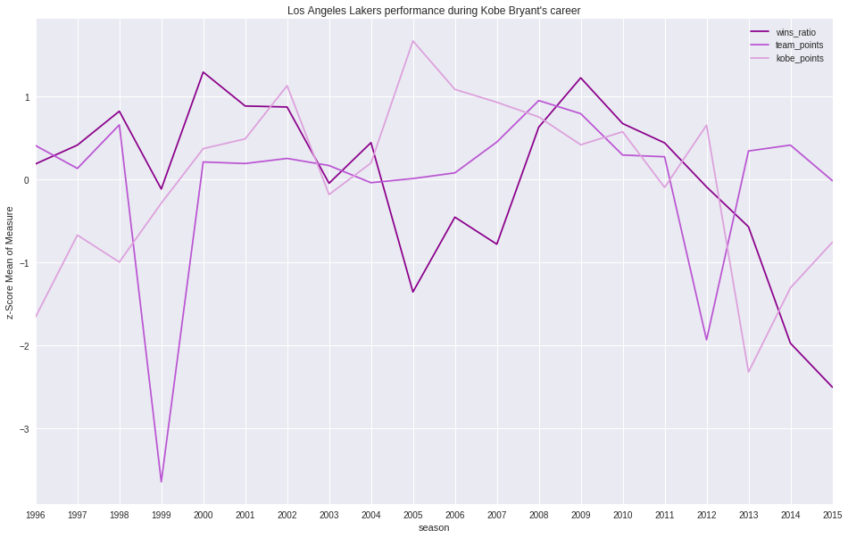
Exploring the Dataset – Part 2
Team wins fell off sharply toward the end of Kobe’s career, more often from his injuries and inversion of points.
Kobe’s points were inverted from team points in most of the final years of his career.
The first year at the Staples Center showcased a mediocre lack of team wins and the lowest amount of team points throughout all of Kobe’s career.
Kobe points
Kobe points
Win ratio
Team points

Slide 29
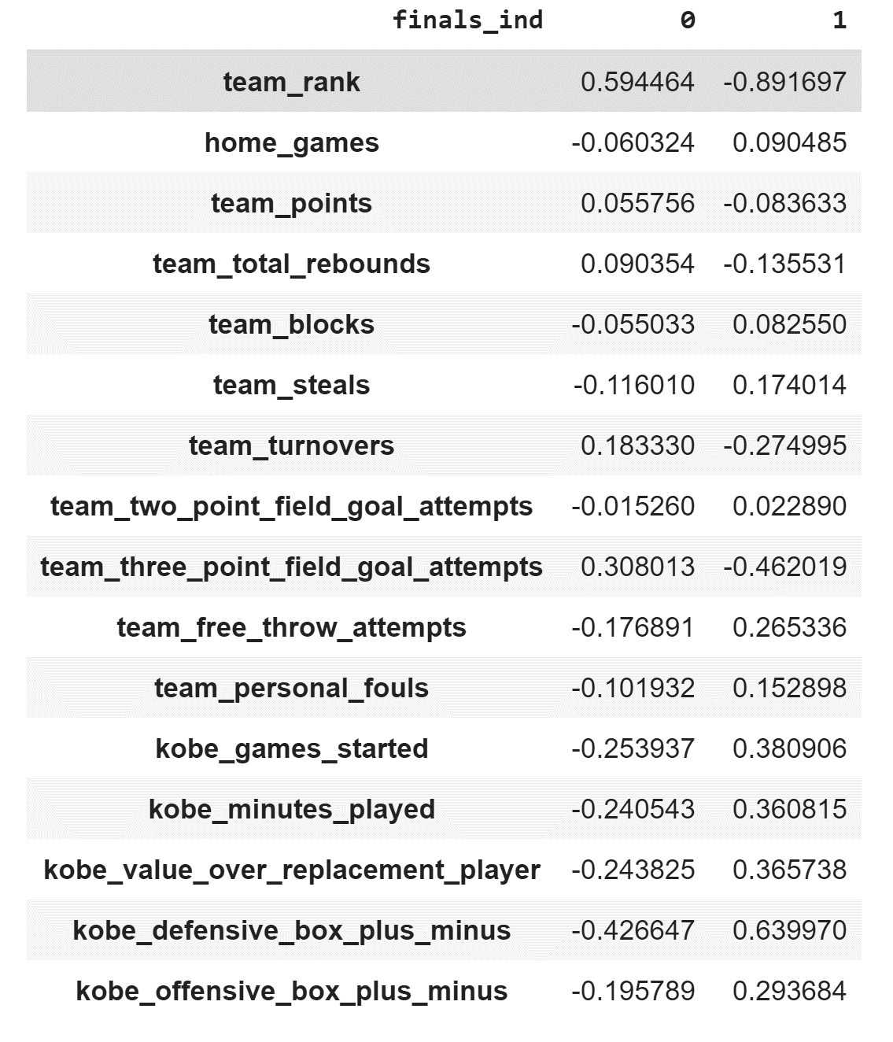
Exploring the Dataset – Part 2
When the Lakers finish as one of the top 4 teams in the NBA (finals_ind = 1), some notable differences emerge in team performance.
In years the Lakers finished in the top 4, team points were slightly lower, but steals and rebounds were much improved from other years.
Kobe’s measures are generally more susceptible to change. Years in which his ‘Defensive Plus/Minus’ was significantly better signaled a top four team finish.
Data Source: Final dataframe – Part 2

Slide 30
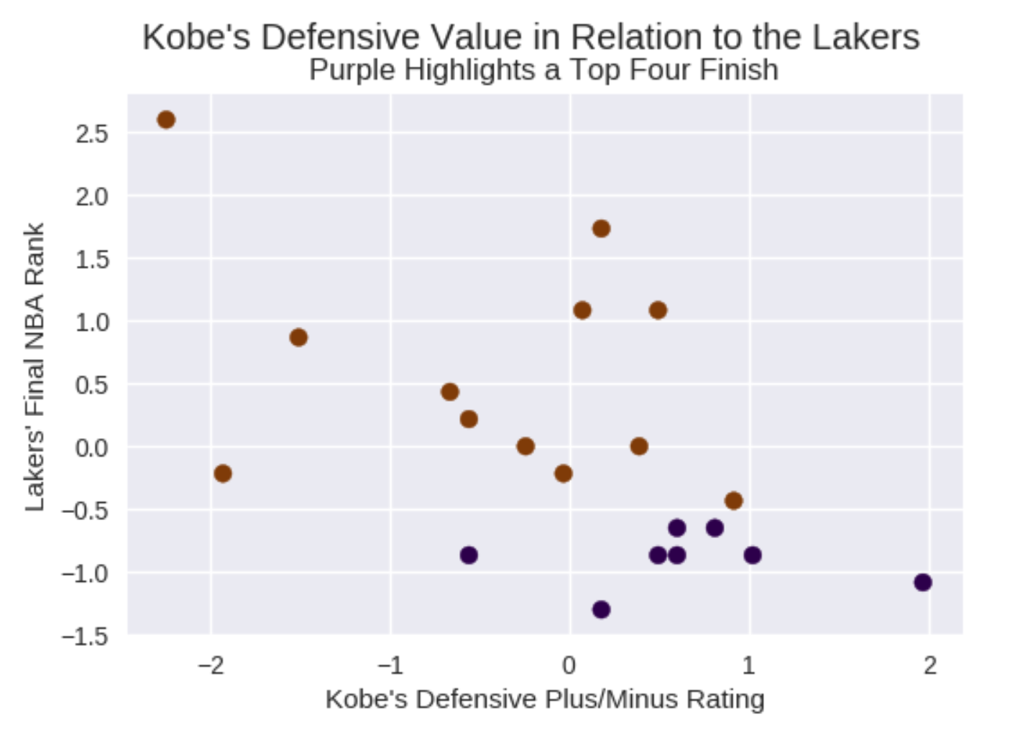
Exploring the Dataset – Part 2
Kobe’s defensive performance appears to be linearly correlated with better overall team performance (as measured by final NBA rank).
The linear relationship is not perfect, but does highlight an overall trend in most years. This measure can be affected by additional support from other star players on the Lakers (ex. Shaquille O’Neal)
Top 4 Finish

Slide 31
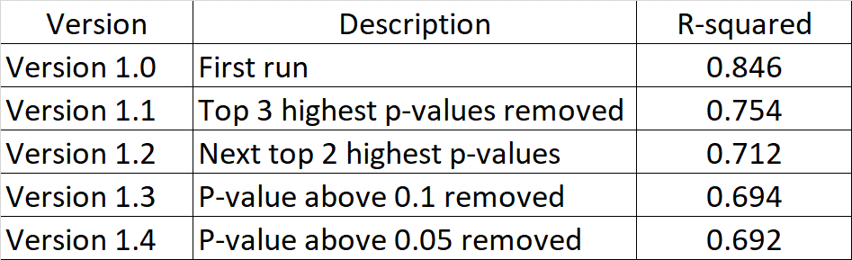
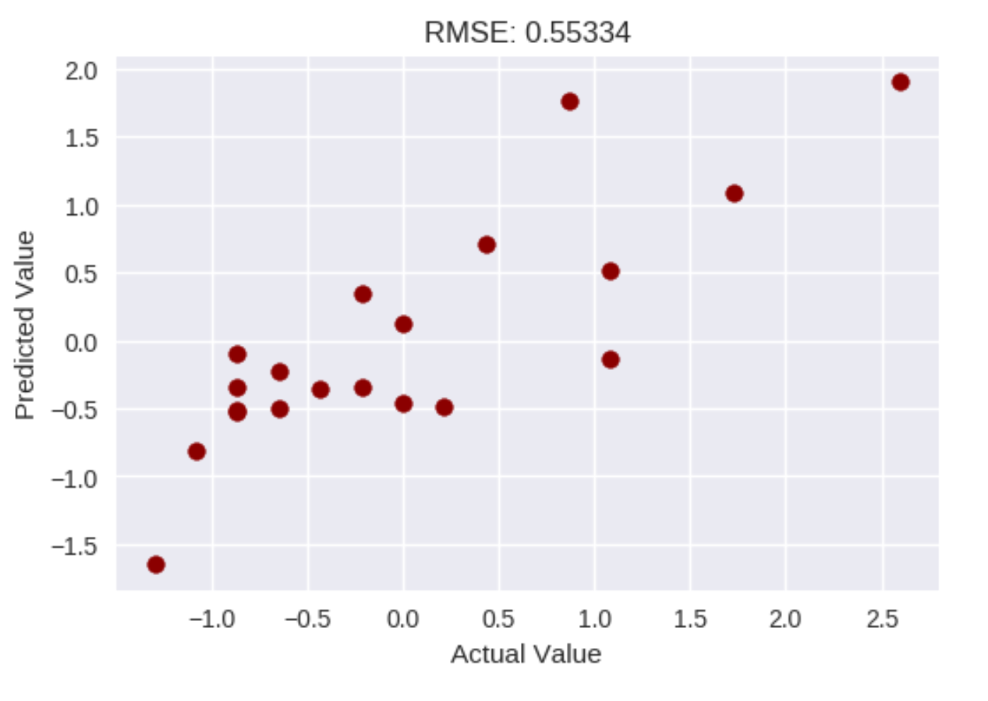
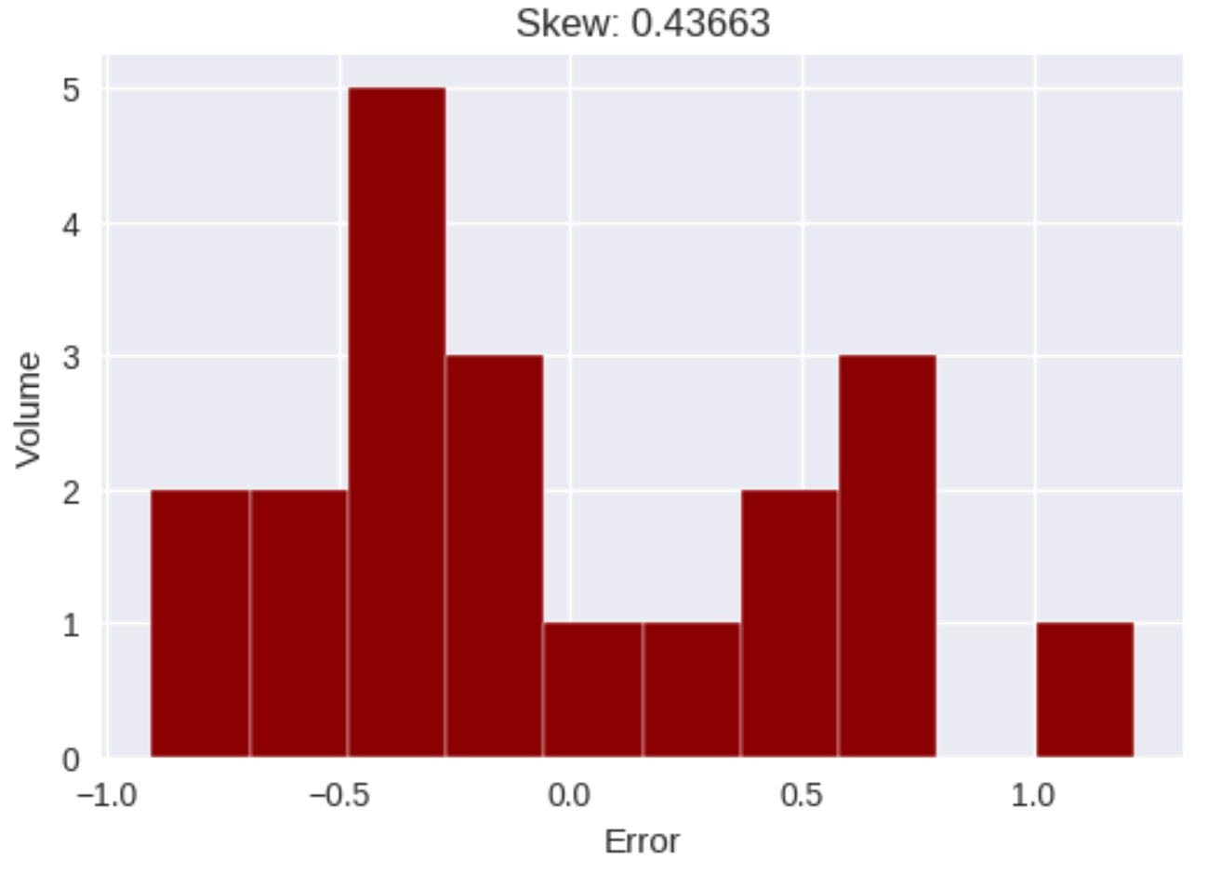
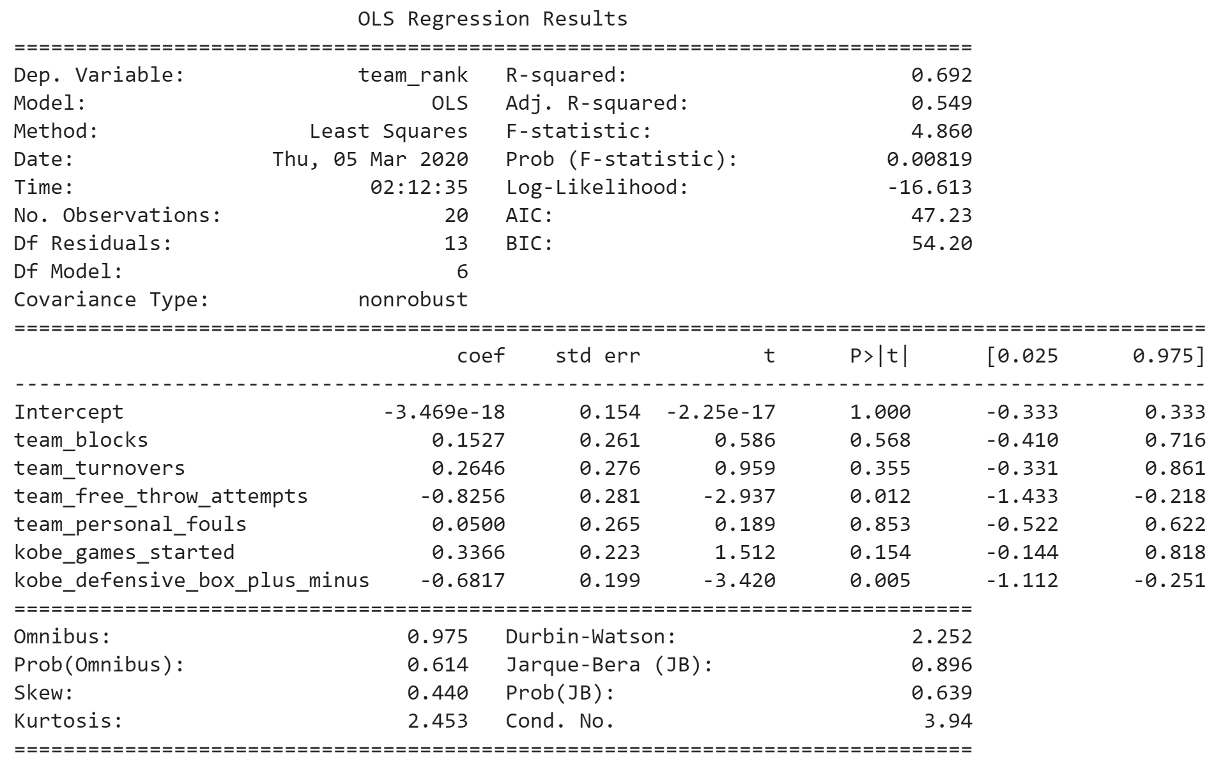
Model – OLS Regression – Part 2
Version 1.4:
Linear relationship exists between Kobe’s and the Lakers performance and the final NBA ranking.
Team Free Throw Attempts and Kobe’s Defensive Plus or Minus Ratio are the strongest predictors.
Model underpredicts by approximately half of a std dev.
RMSE is bimodal with a higher propensity to predict a slightly better than actual rank.

Slide 32
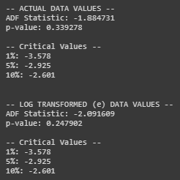
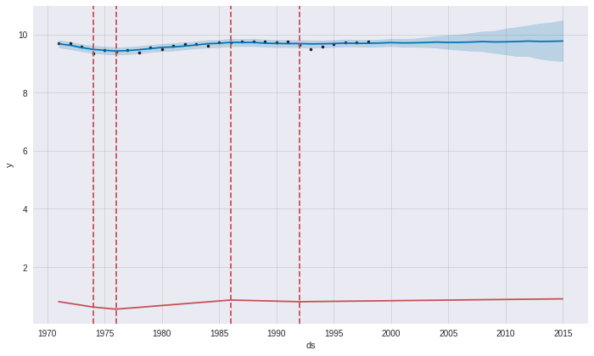
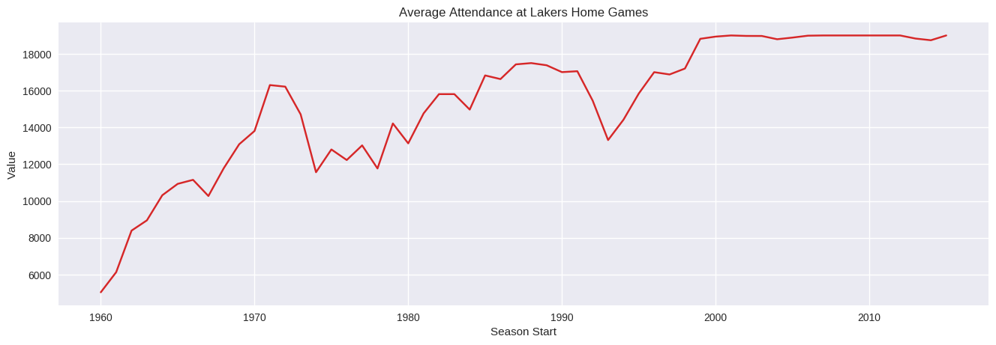
Time Series – Part 2
Prior to the opening of the Staples Center, the Lakers could have experienced a variety of attendance results. The time series was not stationary, even after log transformation.
As shown below, four periods of attendance change occurred from 1970 through 1993. If included the opening of the Staples Center, in 1999, would have been noted as a significant change.
The Lakers ultimately averaged a near-sellout during the peak of Kobe’s career, only slightly decreasing at the tail end. The FB Prophet forecast produced a RMSE of +1,424 people from ‘99.
Data Source: Attendance – Part 2

Slide 33

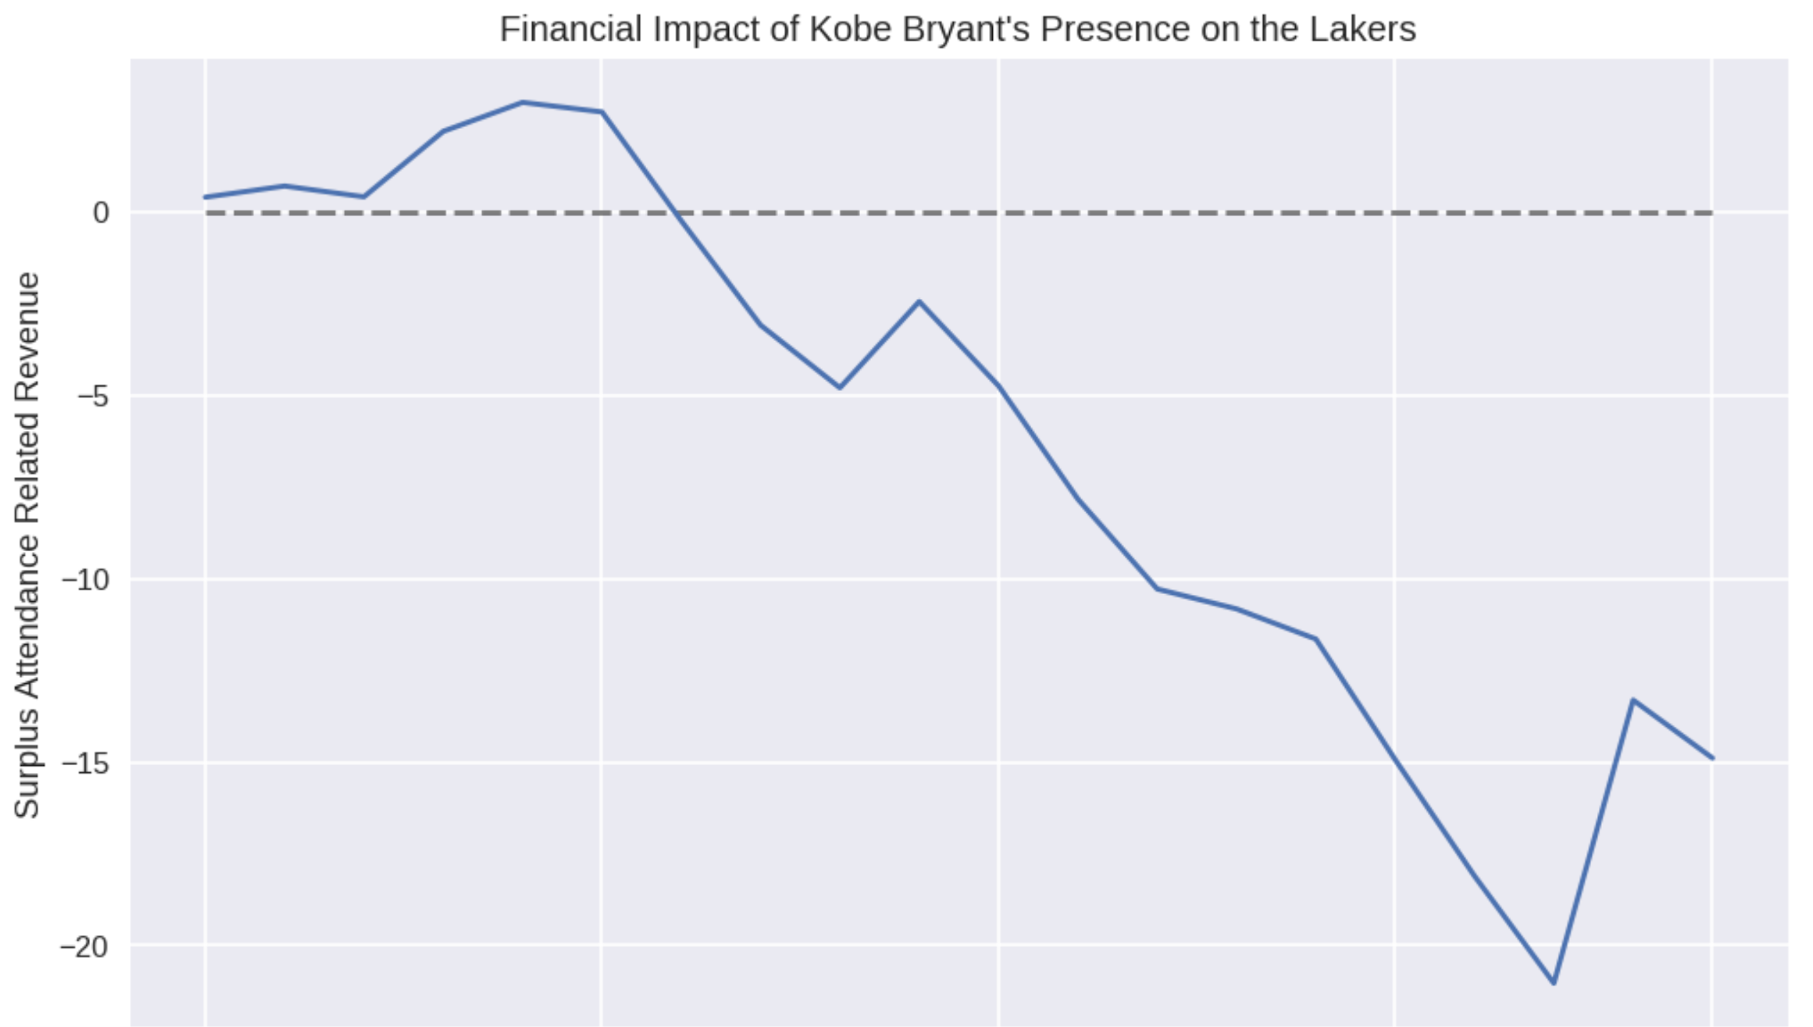

Exploring the Dataset – Part 2
Million USD
Given that Kobe’s play, especially defensively, made an impact on the overall team performance and overall team performance draws attention to the franchise
(ex. attendance, merchandise sales, etc.):
The financial impact of Kobe Bryant is being assessed as the difference between expected and actual attendance, weighted by Kobe’s use throughout the season (minutes played, injuries, etc.), and reduced by Kobe’s salary.
This measure shows a net gain for Lakers from 1996 through 2002, then declining through the end of Kobe’s career as his salary increases.
Even though the Lakers won five championships throughout Kobe’s career (2000 - 2002, 2009, 2010), an attendance capacity diminishes the financial impact of one player.
Albeit, this is a conservative view of a player’s financial impact.
$3M
Kobe’s salary increased over time

Slide 34
Kobe’s jump shots with majority of the shots only had 39% success rate, while dunk had the highest success rate at 93%.
Shot were more successful when executed from the center of the court.
Ticket prices and general fans costs were positively correlated with Kobe’s salary.
Attendance grew sharply with the opening of Staples Center, and held flat throughout Kobe’s career.
Kobe created a “surplus” of $3M during 2000 – 2001 season, winning the NBA championship.
The surplus Kobe created started to decline in Y2002 until his retirement, but Lakers franchise value started to increase in Y2010.
Conclusion

Slide 35
Explore the upward trend of the franchise value after Y2010 .
Comparison of his statistics and impact to team’s profitability as compared to other basketball legends and teams
(e.g. Michael Jordan, LeBron James, 1988 to 1990 Detroit Pistons, etc.).
Kobe’s defensive winning style as compared to other player’s style in winning a game.
Extrapolate on how a weighted shot has an impact to overall team win as compared to other measurements.
Extrapolate how intermingling younger players, with lower salaries, can augment star players to create a cost effective but high performing (championship) team.
Recommendations

Slide 36
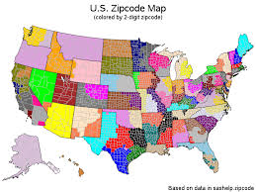
Three Zip Codes in the US to Invest

Slide 37
Volatility of the housing market in the US.
Application of latest technique in forecasting with data science.
Motivation

Slide 38
Which three zip codes to invest given historical data and other factors to consider.
Factors to consider in recommending a decision.
Business
Questions

Slide 39
The Collection of Data
Zillow Median Home Values
files.zillowstatic.com/research/public/Zip/Zip_Zhvi_SingleFamilyResidence.csv
Median Household Income for Y2018
https://www.ers.usda.gov/data-products/county-level-data-sets/download-data/
Crime Rates and Population
Extracted from Kaggle with Y2016 crime rates by county in the United States. Title from Kaggle: “United States Crime Rate by County

Slide 40
Pre-Processing and Data Cleaning
Dealing with Missing Values, Cleaning and Transforming Data
Zillow Data:
Dropped data from Apr 1996 to Dec 1996.
Added “Growth” rate column by taking the Dec 2019 data and dividing it by the Jan 1997 data.
Added “std” or standard deviation column by taking data for the past 10 years from Jan 2010 to Dec 2019.
Added “mean” column by taking data for the past 10 years from Jan 2010 to Dec 2019.
Median Household Income for Y2018:
Retained only columns County Name, State and Median Income.
Crime Rates:
Retained only columns County Name, State and Crime Rate Income.

Slide 41
Pre-Processing and Data Cleaning
Merging of Data
First merge:
Merged Zillow and Crime Rate data frames joining through “County Name” and “State” columns.
746 observations were dropped from 30,434 to 29,688.
Second merge:
Merged “First merge” with the Median Household Income joining through “County Name” and “State” columns.
This time, 29,519 observations were left or only 169 observations were dropped from the first merge.

Slide 42
Pre-Processing and Data Cleaning
Further Cleaning Transformation After Merging Data
Kept rows with at least 60% non-NA values, which resulted to 23,044 observations left.
Removed rows with crime rates of more than 1.27% (taken from 25% quantile of Crime Rate data), which resulted to 3,954 observations.
Removed rows with median income of at most $59,000 (taken from 75% quantile of Median Household Income data), which resulted to 1,151 observations.

Slide 43
Pre-Processing and Data Cleaning
Transformation After Choosing Top 10 Zip Codes
Dates as columns had been reset as index.
Re-assigned index as “ds” which is a requirement in using fbprophet.
Converted new index to datetime.
Re-assigned zip codes as “y.”
Generated fbprophet output functions (can be seen from Jupyter Notebook file) for the Top 10 Zip Codes

Slide 44


Exploratory Data Analysis
From the top 20 zip codes nationwide based on growth rates, majority of the zip code were all out of California and only 1 few from New York.

Slide 45


Exploratory Data Analysis
Time Series plot for Hot Springs, Little Rock, Fayetteville, and Searcy in Arkansas.

Slide 46


Exploratory Data Analysis
Top 10 Zip Codes from the final data frame after merging all the data sorting from the highest growth rate.
Delaplane, VA
Winter Park, CO
Underwood, WA
From the top 10 zip codes nationwide based on growth rates, 3 came out of Minnesota, 2 from Oregon, 2 from Colorado, 1 from Washington, 1 from Virginia, and 1 from Idaho .
Top 3 in terms of growth rates were Underwood, WA, Winter Park, CO and Delaplane, VA, which grew by around 250% from Jan 2017 to Dec 2019.

Slide 47



Models
Showing results from running the fbprophet of top 3 zip codes based on highest growth rates from Jan 1997 to Dec 2019. (Note: Results from the remaining zip codes can be found from the Jupyter Notebook file.)
Zip Code 98651 – Underwood, Washington
Underwood, WA has the highest growth rate of 274% from Jan 1997 to Dec 2019 with a median house value of $530K as of Dec 2019.
We used 12 months or 365 days as horizon in predicting performance, and 204 months prior as training data.
Picking on MAPE over 365 days horizon, forecast error range is from 2% to 4% (see graph).

Slide 48



Models
Zip Code 80482 – Winter Park, Colorado
Winter Park, CO has the second highest growth rate of 249% from Jan 1997 to Dec 2019 with a median house value of $676K as of Dec 2019.
We used 12 months or 365 days as horizon in predicting performance, and 204 months prior as training data.
Picking on MAPE over 365 days horizon, we see that forecast error range is from 2% to 6% (see graph).

Slide 49



Models
Zip Code 20144 – Delaplane, Virginia
Delaplane, VA has the third highest growth rate of 247% from Jan 1997 to Dec 2019 with a median house value of $676K as of Dec 2019.
We used 12 months or 365 days as horizon in predicting performance, and 204 months prior as training data.
Picking on MAPE over 365 days horizon, we see that forecast error range is from 2% to 5% (see graph).

Slide 50



Models
12 Months Forecast – Y2020

Slide 51

Models
Growth rates from Dec 2019 to Dec 2020 highlighting the initially chosen Top 3 zip codes.

Slide 52

Conclusion
Using fbprophet as forecasting algorithm helped us use the outputs in determining the forecast in the next 12 months of Y2020.
Main considerations were growth rates from Dec 2019 to Dec 2020, absolute change or increase in value and MAPE.
The final Top 3 zip codes recommended were 98651-Underwood, WA, 80482-Winter Park, CO and 97031-Hood River, OR.
The combined growth rate from Dec 2019 to Dec 2020 was estimated to be around 9.75% and absolute change or increase of $165K in a 12-month period. In short, investing a total of $1,693K as of Dec 2019 median home value for the 3 zip codes was forecasted to be $1,858K by Dec 2020.

Slide 53
In the interest of time in getting more data or information, these analyses were scoped down to only using crime rates and median household income in filtering the data.
Information like economic growth rates, unemployment rate, infrastructure development scoring, and investment scoring can be used.
Moreover, recommending the Top 3 zip codes also depends on the available resources as a consideration that wasn’t provided for this case study.
Recommendations

Slide 54


Inbound Crossing at the US-Canada and US-Mexico Border

Slide 55
Motivation
The main goal of this project is to provide insight on some questions in relation to people crossing the US-Canada and US-Mexico border from years 1996 to 2018.
The idea is to present a poster using Adobe Illustrator that can walk through readers some questions showing through visual communication.
Moreover, some readers are drawn to paying more close attention to colors, maps, graphs, and some facts which the poster which reflect on.
The output can also be educational to students who are interested at a quick glance some facts on immigration which is one of the political highlights of the country.

Slide 56
Business Questions
How many have entered the United States from the Canadian and Mexican ports from Y1996 to Y2018?
What is the split of border crossing coming from Mexico and Canada?
Which states do people cross from?
What are the top 10 port of entries?
What are the mode of entries?
How many pedestrians have crossed the border? What is the trend?
Which states are pedestrians crossing from?
What are number of pedestrians crossing by port?

Slide 57

The Collection of Data
The 35MB csv data was sourced from Kaggle (https://www.kaggle.com/akhilv11/border-crossing-entry-data) with 344,369 rows and 9 columns
Read the downloaded csv file using R.

Slide 58
Pre-Processing and Data Cleaning
Abbreviation state names to .
Renamed “measures” or modes of entry.
No NaN values were found from the dataset.

Slide 59


Exploratory Plots
Entries in the United States from Y1996 to Y2018.

Slide 60

Exploratory Plots
US States where people cross into.

Slide 61

Exploratory Plots
Top 10 port of entries.

Slide 62

Exploratory Plots
Mode of entries

Slide 63

Exploratory Plots
Number of pedestrians crossing the border.

Slide 64

Exploratory Plots
Number of pedestrians crossing the border.

Slide 65

Final Poster

Slide 66
Thank You!

